Slide 1

Getting started on your Climate Action Plan
Ruth Stacey and Fiona Protheroe
E: healthyschools@northyorks.gov.uk

Slide 2

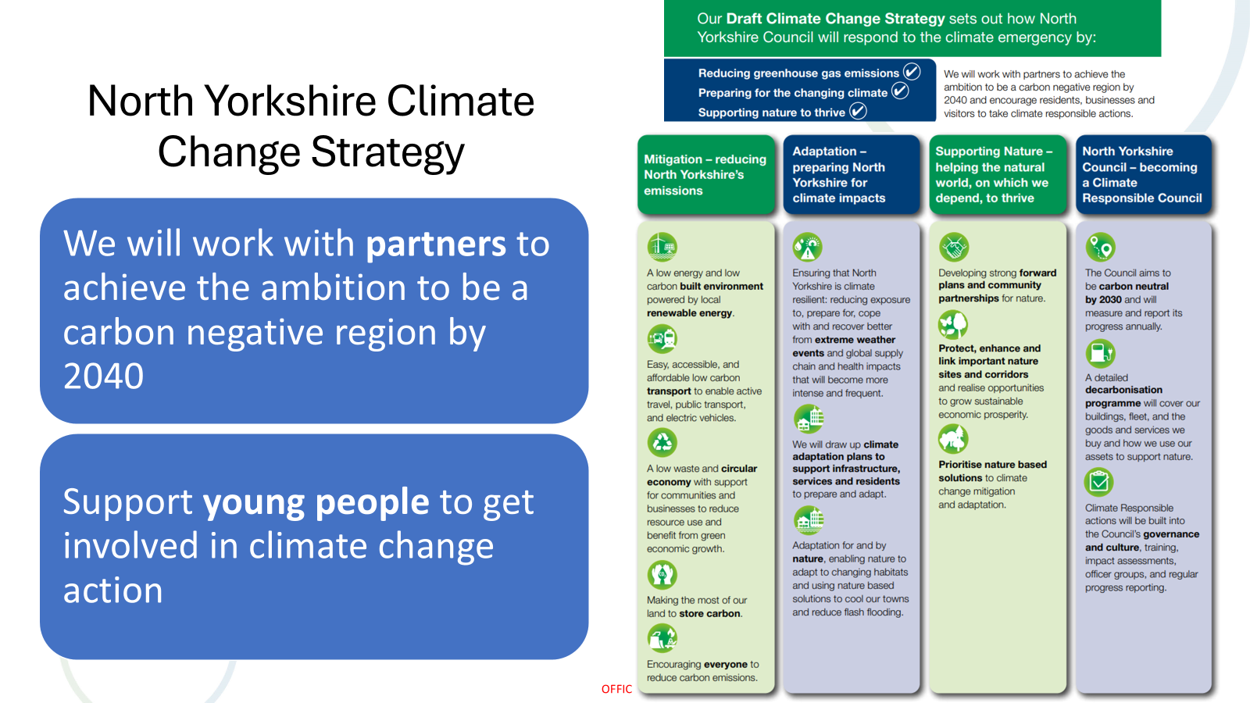

Slide 3
Why Climate Change?
Climate Change Education is vital for all children and young people to navigate the complexities of our rapidly changing world – DFE strategy
Students gain knowledge, skills and values to protect and preserve our planet, and know what actions they need to take
Empower future generations in addressing the challenges posed by a changing planet.
Addressing the interests of children and young people in nature and environment
Contribute to a more positive future for the planet
Reduce eco-anxiety.

Slide 4
Climate Action Plan
Who needs a Climate Action Plan? The DfE sustainability and climate change strategy for education states: “By 2025, all education settings will have nominated a sustainability lead and put in place a climate action plan”.
What is a Climate Action Plan?
A plan to take action in school to do less harm to the planet and bring about positive change, reduce resource use and minimise waste.
Why do a Climate Action Plan?
Showing children the value of resources from an early age helps to establish positive habits as future stewards of the planet.
Helps you to run a more efficient setting where resources aren’t wasted.

Slide 5




Climate Action Plan
What needs to be in your Climate Action Plan?
The plans have 4 themes, you should aim to do at least one action in each:
Saving energy and reducing waste (Decarbonisation)
Be ready for a changing climate (Adaptation)
Looking after nature (Biodiversity)
Learning about the environment and how to
look after it (Climate Education)

Slide 6
Free Support to develop Climate Action Plan
Climate Ambassadors Programme – Free support tailored to your needs where your school will be matched with a Climate Ambassador to support you to develop your climate action plan.
Contact: Ruth Green - climateambassadors_yh@leeds.ac.uk
Climate Action Advisors - Lets Go Zero - Free support, particularly around tackling energy and writing your climate action plan.
Contact: letsgozero@ashden.org
The National Education Nature Park follows a 5 step programme of nature-based learning and action to improve your site for people and wildlife.
Contact: YorkshireNaturePark@rhs.org.uk
Resources & Support for Schools - Climate Change > Healthy Schools North Yorkshire

Slide 7
Creating Your Climate Action Plan
Get your team together.
Who is your sustainability lead? Who will support them? Can you have a group – include a governor, student team, parent lead?
2. Establish a baseline - review what resources you use at the moment. You could start by focusing on:
Energy and Water – your water, gas and electricity use and who provides this.
Food – what do you buy, where from and is there any wastage or excess packaging?
Products – what things you buy, what is it made of, how does it get to you, and how do you dispose of it?
Transport - How do your staff and children get to the setting and out and about on any trips/activities ?
Grounds – what grows in and lives on your school grounds

Slide 8
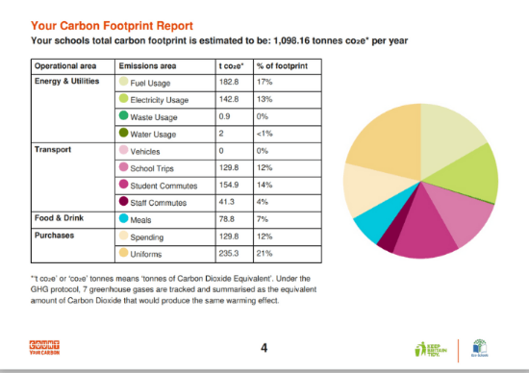
Creating Your Climate Action Plan
1. Establish a baseline – Decarbonisation Home - Count Your Carbon

Slide 9
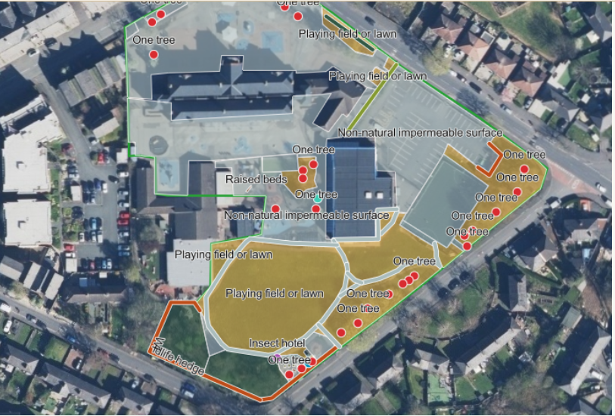
Creating Your Climate Action Plan
1. Establish a baseline – Biodiversity Home | Education Nature Park
Using GIS technology and fieldwork with students to identify the exact habitats in their school grounds Habitat mapping, collecting data stored in the online tool, enabling you to measure and track the gains you achieve for nature throughout the Nature Park programme.

Slide 10
Creating Your Climate Action Plan
2: Focus on the areas you want to change, note that you can’t do everything at once, what are things that you can do easily now, or which will take more time (and money). Choose small actions, short term actions and include things you’re already doing. Recognise big actions might take longer and require a lot of funding – can include these but note timeframe.
SMART objectives: Specific, Measurable, Achievable, Relevant, and Time-bound.
3: Keep updating your plan, note when you complete actions and then add new ones. Include governance details in your action plan – who report to and who often?
4: Share information on activities and progress with parents and the community . Newsletters, website, events, artwork, campaigns?

Slide 11
Climate Action Plan
What needs to be in your Climate Action Plan?
The plans have 4 themes, you should aim to do at least one action in each:
Saving energy and reducing waste (Decarbonisation)
Be ready for a changing climate (Adaptation)
Looking after nature (Biodiversity)
Learning about the environment and how to
look after it (Climate Education)

Slide 12
Example actions: 1 Decarbonisation – Saving energy
Save energy – turn down heating
Save energy - Can children help with switching off lights. Have posters/ signs up to remind people. Review energy bills and supply. Is there any wastage at weekends, in evenings or holidays? Can LED lights be fitted or more efficient lightbulbs?
Reduce waste –compost the fruit and veg snack waste – invite the North Yorkshire Rotters into school (compost and wormery workshops, smoothie bike) contact Jeff.Coates@northyorks.gov.uk
Reduce waste –help parents reduce buying new for their children though organising uniform, clothes and toys swaps and events.
Sign up to Energy Heroes ( Primary)

Slide 13




Our Vision
To enable school communities across the UK to become models of energy efficiency
Our Aim
To improve data handling and problem-solving skills for pupils in Year 5
Our Objectives
Provide teachers with the support and high-quality resources to achieve our aim
To deliver a highly engaging programme that enables schools to act as knowledge hubs for energy and climate change
Sign up here: Energy Heroes
To empower children to become messengers who model behaviours that reduce CO2 emissions and reduce fuel poverty
Background

Slide 14
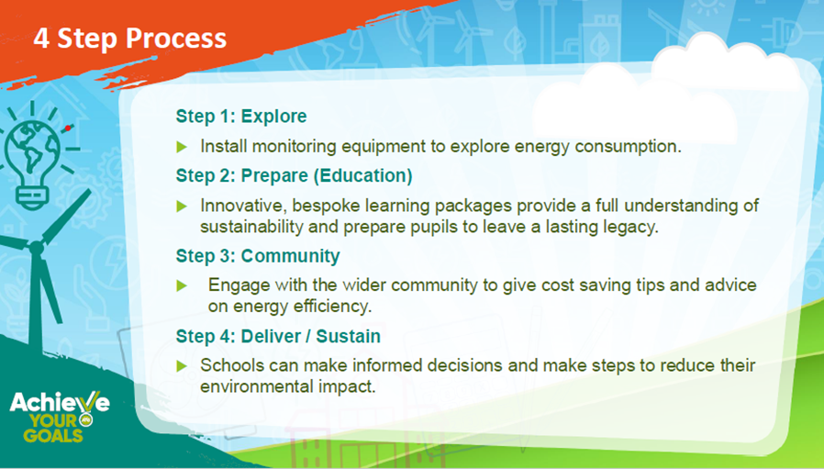
Achieve Your Goals – Energy Progrmme
Achieve Your Goals CIC has developed a package of learning that incorporates literacy, numeracy, and reading to allow pupils to fully understand the topic.
To sign up contact - Rachel Greaves, Project & Education Coordinator
Tel: 01709 212005 / 07496 559507
Website: https://www.achieveyourgoalscic.co.uk/
Rachel Greaves Rachel@achieveyourgoalscic.co.uk
New Funding for 4 schools in North Yorkshire

Slide 15
More example actions: 1 Decarbonisation – Saving energy
Save energy - transport by setting up a walking bus or organise a walk to school day - contact Sustainable Travel team for support and visit from Spike the Hedgehog Chrystal.Staveley@northyorks.gov.uk (Primary)
Save energy - transport– Join Modeshift’s Active Travel Ambassadors scheme (secondary) contact: Jason@modeshift.org.uk
Save energy - transport – go on a trip by bus or train or walk
Save water - by appointing children as water savers, take turns to check taps are turned off.
Save Water (Primary)– KS2 Join a Yorkshire Water live learning event (21 January 2026, 11 March 2026, 6 May 2026, 1 July 2026)
Save Waste (Secondary) – Book a Yorkshire Water Period Poverty workshop (includes free sustainable period projects)

Slide 16
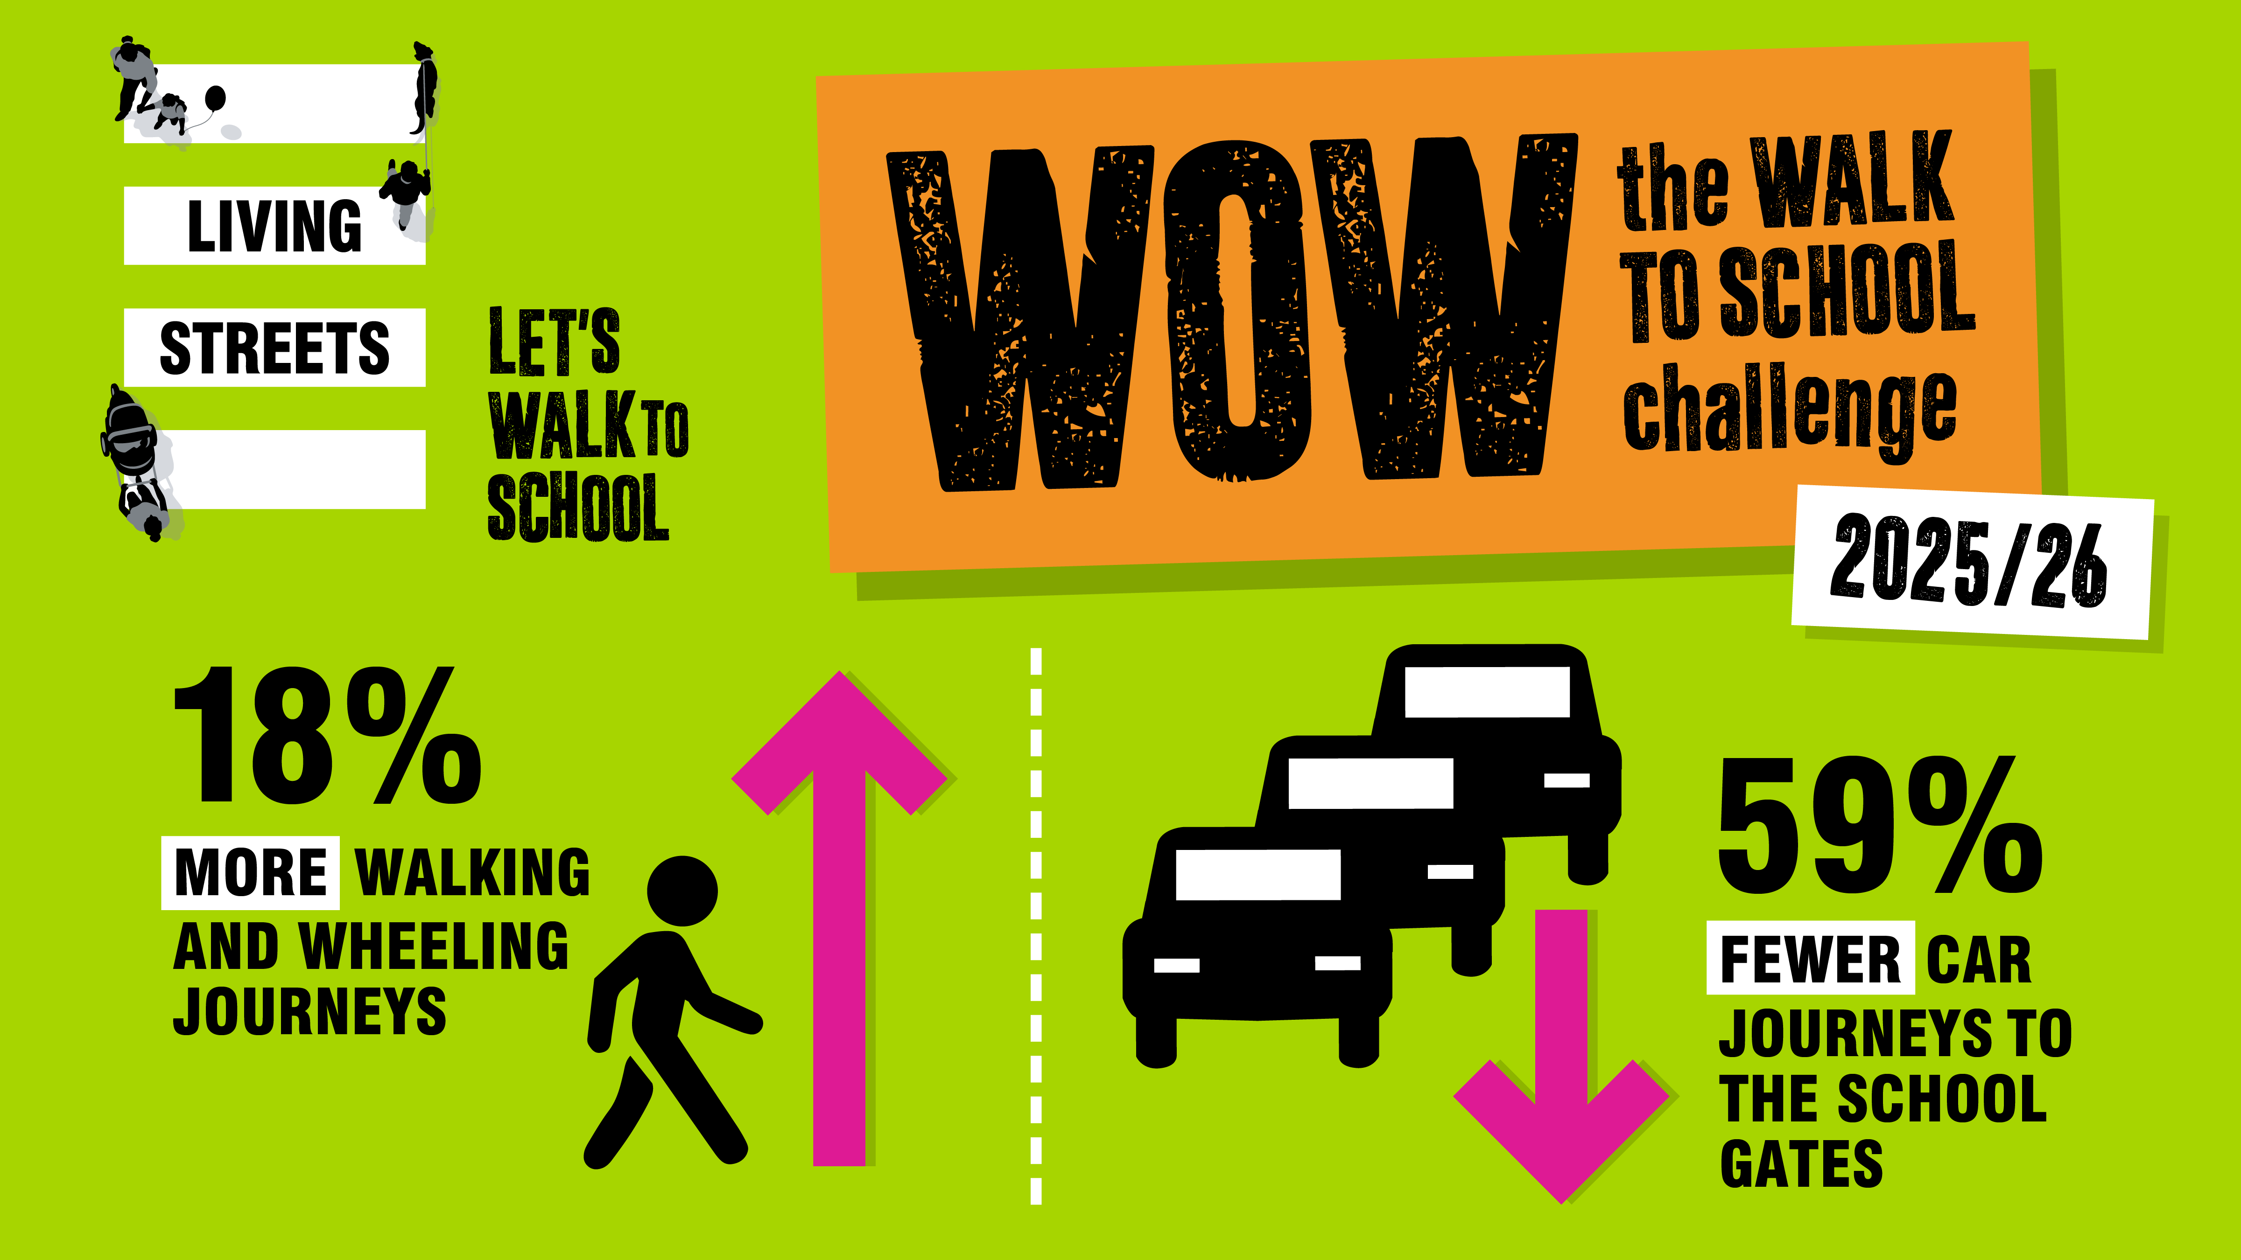
WOW - the walk to school challenge
WOW is a pupil-led initiative run by UK charity, Living Streets.
Children self-report how they get to school every day, with those who walk, wheel, cycle, scoot or Park and Stride at least once a week awarded collectible WOW badges. WOW has been helping to reduce congestion and pollution at thousands of schools for 20 years.
Thanks to funding from Active Travel England, schools in North Yorkshire may be eligible for free WOW resources, including access to the WOW Travel Tracker.
To sign up contact - Abi Gibbons (she/her),
Project Coordinator - Walk to School Outreach
Yorkshire and North East Team,
abigail.gibbons@livingstreets.org.uk | 07702669273

Slide 17

Example actions: 2. Be ready for a changing climate
This section is about being prepared and ready for the changes that happen as a result of climate change.
Monitor indoor and outdoor temperature
Write a plan for keeping cool in hot weather – this could include - water based play, outdoor learning, changes to uniform, changes to building ( blinds) etc, drinking water
Planting can help keep things cool and provide shade – plants trees in grounds if enough space or add greenery in pots.
Do staff know what do in case of flooding? – write a plan
Install rainwater harvesting (e.g. water butts or planters) to conserve water elsewhere in site and reduce flood risk
Maintain your gutters by clearing them regularly

Slide 18

Example actions: 3. Looking after Nature
Learn about how to identify plants and wildlife – take part in events – Big Garden Birdwatch ( 23-25 January 2026), Big Butterfly Count ( summer 2026)
Encourage more nature around your site – grow indoors and out - plants, wild flowers, trees Free Trees for Schools and Communities - Woodland Trust
Make insect homes – bug and bee hotels
Make bird feeders – take note what birds come and feed
Spend even more time outdoors – listen, play and take notice
Explore the Hedgehog Friendly Schools Install a pond and use it as a key learning resource
Start a gardening club and grow food for your kitchen
Keep Bees
This section is about finding ways to increase children’s connections to nature – helping them be at ease being outside, and coming into contact with soil, plants, animals and wildlife. Increasing biodiversity and homes for nature in your own setting.

Slide 19
Example actions: 4a. Learning about Climate Change
Involve children in all the actions in the climate action plan, and find learning opportunities to talk about how to look after the planet and nature
Do a curriculum review and add in Climate Change teaching opportunities
Set up an Eco- Council, and use Eco-School framework for students to plan and lead activities and projects
Support staff and provide CPD on climate education and green skills - Free Carbon Literacy training from Let's Go Zero
Involve students in promoting actions and messages - encourage your learners to create pieces or art, write poetry etc. that focus on climate action
Take part in Awareness Days - dates and lesson plans
Global Days › Reboot Education

Slide 20
Example actions: 4b. Learning about Green Skills and Careers
Green Careers is employment in an activity that directly contributes to - or indirectly supports - the achievement of the UK's net zero emissions target and other environmental goals
Green skills “the knowledge, abilities, values and attitudes needed to live in, develop and support a society which reduces the impact of human activity on the environment”
Sign up for Young Green Briton Challenge ( students11-16) learn and apply skills to design solutions to local sustainability issues
Include Green careers options
  Net Zero toolkit for schools and Employers
  Green Jobs; Presentation for Schools
  Virtual Work experience - Environment Agency
  Exploring Careers In Natural Flood Management - Slow The Flow
  Careers for our future environment – YouTube
  Sustainable Futures - free secondary schools programme | WWF

Slide 21
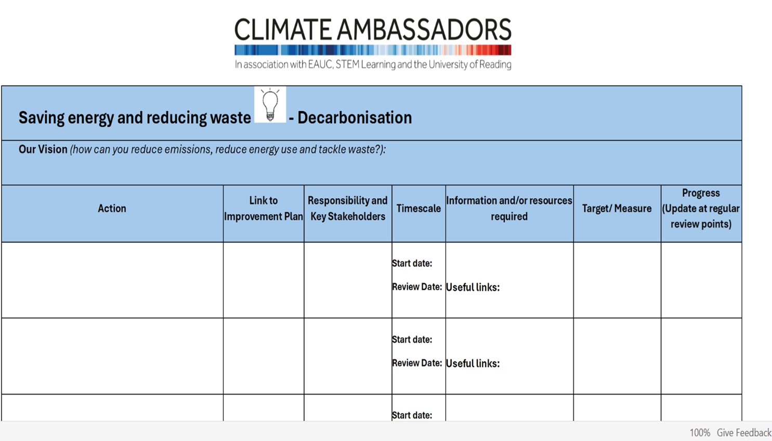
Example template - Climate Action Plan > Healthy Schools North Yorkshire

Slide 22
An example Climate Action plan
Climate Action Planning – Longman's Hill Community Primary School
Sherburn Hungate Primary School - Climate Action Plan
Filey Junior School
Thirsk School and Sixth Form College Climate Action Plan

Slide 23
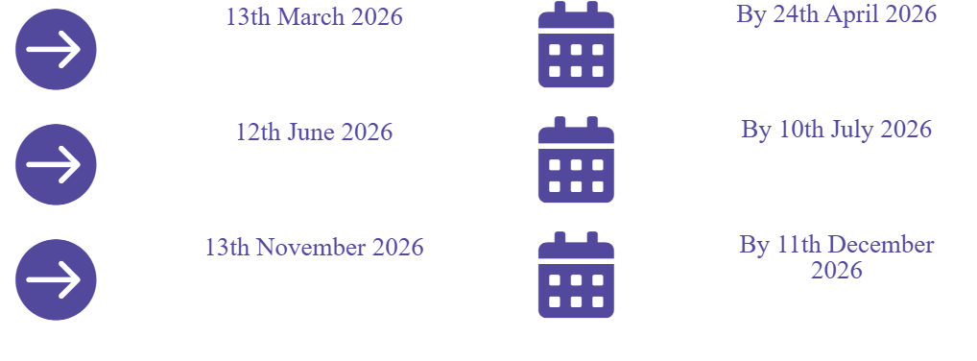
Timetable
DfE has asked for Climate Action Plans by the end of December 2025 but we are also tying in with our existing Healthy Schools award submission dates for you to upload your plan by.

Slide 24
Get a Climate Action Plan logo and certificate
Download your climate action plan template here (or create your own)
Climate Action Plan > Healthy Schools North Yorkshire
UPLOAD your completed climate action plan here:
Start Award > Healthy Schools North Yorkshire
You will need an existing Healthy Schools login or register to set up an account.
A Climate Action Plan logo and certificate will be sent out to you after your plan has been looked at by our partnership group.

Slide 25
Keeping up to date & next steps
Upload plan to Healthy Schools website
Climate Change newsletter?
Network meetings ?
Spring term Climate Change pupil event primary – Allerton Waste Recovery Centre – date to be confirmed.
Don’t forget to register on the Healthy schools website healthyschoolsnorthyorks.org
Check we have your preferred email address for future emails about training, events etc
Any problems, email healthyschools@northyorks.gov.uk

