Slide 1
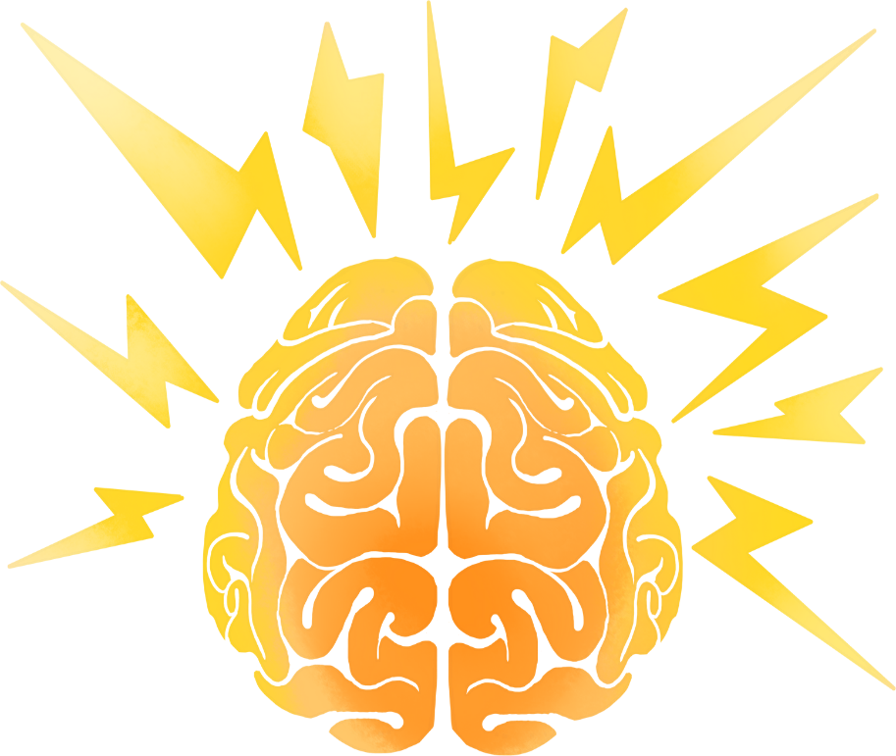

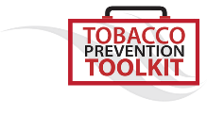
Lesson 1: Be nicotine free
Notes:
Teacher:
We will be starting our vaping, tobacco, and nicotine unit today.

Slide 2
Today you will learn about
  Nicotine and your brain
  Addiction
  Nicotine products and your body

Slide 3



YOUR BRAIN'S JOB
Find healthy relationships
Find new skills
Find what feels good
FRIENDS
FUN
FAVORITE
Notes:
Teacher: Right now, your brain's job is to learn:
how to build healthy relationships and (it’s why you probably care a lot about your friends and relationships);
find and build new skills and figure out what makes you feel good (it’s why having fun is probably a top priority for you);
You probably already have favorite types of music, favorite foods, and favorite hobbies.

Slide 4
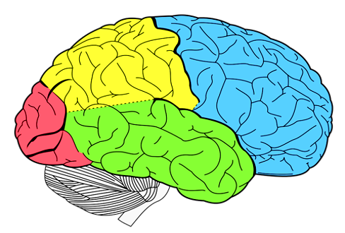
Adolescent Brain
FRONT
Young people are often driven by emotion, excitement, and short-term reward.
Write in your book: Young people’s brains are more vulnerable to damage from drug and alcohol use – creating more risk for immediate and lasting harm.
BACK
Prefrontal
Cortex
Develops during our teens+
Stops developing around age 25
Responsible for impulse control, planning, and judgement
Notes:
Teacher: Our brains develop unevenly “back to front” throughout childhood and adolescence which ends around age 25.
During our teens, the front part of our brain called the prefrontal cortex, which we use to help make decisions, continues to develop.
Reference: http://www.drugfree.org/why-do-teens-act-this-way/adolescent-brain-and-behavior/

Slide 5

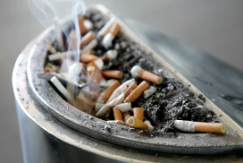

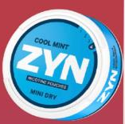
Drugs and the brain
While the brain is developing and looking for things it likes, it can easily be tricked by drugs, like nicotine.
Drugs trick the brain by making it think it likes the drug, and making it feel good…at first.
Write in your book: Nicotine is the drug that is in vapes, cigarettes, and other tobacco products, like nicotine pouches.
Nicotine?
Notes:
Teacher: Nicotine is the drug that is in vapes, cigarettes, and other tobacco products. We will talk more about nicotine soon.

Slide 6

Drugs and the brain
The problem with drugs like nicotine is that eventually, it takes more of the drug to make the person's brain feel good.
Tolerance
The brain and body can start to feel bad when a person stops using nicotine.
Withdrawal
Withdrawal can produce intense anxiety, high heart rate, cravings, and irritability.
Notes:
(Click on image - video).
Teacher: Tolerance is when someone needs to use high amounts of the drug to get the effect the person want. This is because a person's body and brain is used to nicotine. This can look like someone vaping more often or higher concentrations of nicotine or even using more than one type of nicotine product which is highly toxic (poisonous).
The brain and body can start to feel bad when a person stops using nicotine. This is called "withdrawal." It can be uncomfortable and distressing for the person.
Withdrawal can produce intense anxiety, high heart rate, cravings, and irritability.

Slide 7
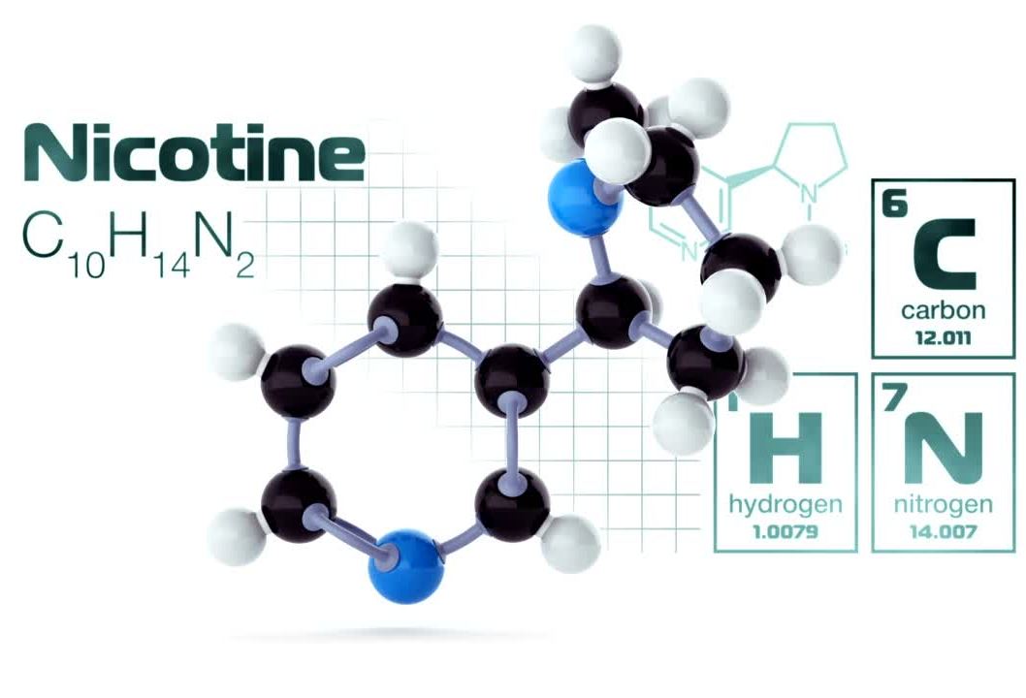
What is nicotine?
  Drug
  Stimulant
  Highly addictive
  Causes changes in brain chemistry
  Found in vapes and tobacco products
Notes:
Teacher:
So, let's talk about nicotine now.
Nicotine is a drug that is a stimulant, meaning it raises levels of physical or psychological activity in the body, and it is toxic at high doses (click on video for animation).
Data from studies of mice suggest that nicotine exposure during adolescence may have lasting adverse effects on brain development.

Slide 8

If nicotine is unsafe, why do you think people still choose to use products that have nicotine?
Notes:
Teacher:
If nicotine is unsafe, why do you think people still choose to use products that have nicotine? (pause for responses).
It's worth repeating that nicotine is a highly addictive drug. There are many definitions and theories on what addiction means.
The human brain can develop such a strong dependence on the drug that the nicotine user can no longer control their desire or vaping/smoking behaviours.

Slide 9
What is Addiction?
Write in your book: Addiction is a complex interaction between our biology, psychology, and social situation.
Social situation means where we live and the spaces where people use drugs like nicotine.
Psychology includes thoughts, beliefs, feelings, expectations and motivations.
Biology includes our brain.
Notes:
Teacher:
There are many definitions and theories on what addiction means.
In this lesson, we are going to use a biopsychological perspective which recognizes that addiction is a complex interaction between biology, psychology, and social situation.
When we say biology, we are including the brain. When we say psychology: thoughts, beliefs, feelings, expectations, and motivations What we mean by social sociation, we mean where we live and the spaces where people use drugs like nicotine.
References:
Denning & Little (2017). Why do some people get into trouble while others don't?
in Over the Influence (p. 83).
https://www.tobaccofreekids.org/assets/factsheets/0127.pdf- delaying use of nicotine
https://www.verywellmind.com/dsm-5-criteria-for-substance-use-disorders-21926

Slide 10
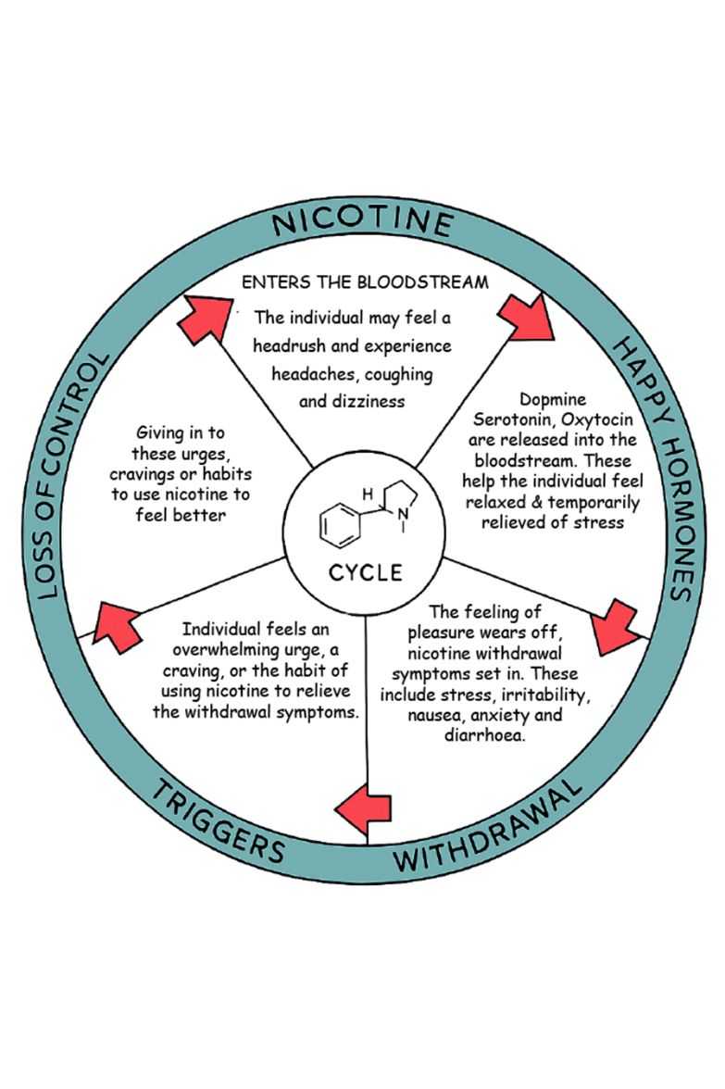

Cycle of Nicotine Addiction
1
This is how people become addicted to nicotine products like vapes, cigarettes, and pouches.
The cycle of nicotine addiction starts with bringing nicotine into the body.
5
2
Your brain continues to crave dopamine after you are done, and you slowly lose control over your choice to use nicotine.
Nicotine enters the brain and activates the parts of the brain that make us feel good.
3
What happens next is the level of nicotine in the body drops quickly.
4
This drop in nicotine levels causes the body to have a strong craving for nicotine that is satisfied only by bringing more nicotine into the body.
Write in your book: Nicotine tricks your brain into feeling good for a short time, but then makes you feel worse, so you keep using it to feel better—even though it’s really making things harder.
Notes:
Teacher:
The cycle of nicotine addiction starts with bringing nicotine into the body. Nicotine enters the brain and activates the parts of the brain that make us feel good.
What happens next is the level of nicotine in the body drops quickly.
This drop in nicotine levels causes the body to have a strong craving for nicotine that is satisfied only by bringing more nicotine into the body.
This cycle is powered by the body’s biological reaction to nicotine and isn’t controlled by the person vaping or smoking.
, some people say they smoke cigarettes or vape because it helps them feel less stressed. That’s because nicotine, the chemical in cigarettes and vapes, tells the brain to release “feel-good” chemicals that make you feel happy and calm—for a little while.
But here’s the catch: that good feeling doesn’t last long. When it wears off, the person starts to feel worse—more stressed, grumpy, or anxious. That’s called withdrawal.
To feel better again, they smoke or vape more. This gives them another short burst of that happy feeling. But soon, the bad feelings come back again. And so the cycle repeats.
Over time, this cycle can make people feel more confused, tired, and unhappy. They start to believe they need nicotine to feel okay, but really, they’re just chasing that short-lived happy feeling again and again.
What many people don’t realise is that it’s not the nicotine they need—it’s the feeling of happiness and calm they’re trying to get. And there are much healthier ways to feel good that don’t involve smoking or vaping.

Slide 11

ACTIVITY: Addiction spectrum
Completely nicotine addicted
Not addicted

Slide 12

ACTIVITY: Addiction spectrum
I used to never vape and now I only vape socially. I’ve noticed I get strong cravings to vape when I’m out with friends lately. It’s getting harder to keep from vaping in social settings.
My friends say that I’m not like myself lately. They say that I get grumpy and moody when I go too long without hitting my vape.
When I first started vaping I only did it occasionally with friends after school. But now I find it impossible to keep myself from vaping, even where I am not allowed to, like school.
I always have to think about how I’m going to fit in my next hit from my vape. I get nervous when I’m somewhere that I can’t have it.
My best friend vapes all the time. I’ve tried it after she kept offering them to me but it gives me a headache. I can’t bring myself to take another hit.
My friend offered me a vape today. After I took a few puffs, I started to cough, and my throat and lungs felt really irritated.
Completely nicotine addicted
Not addicted
I spend so much on vapes it’s ridiculous. There have even been a few times when I couldn’t buy what I wanted to eat.
I feel like I’m really hooked on my vape. It’s more than just a habit at this point.
I don’t always enjoy vaping. I’ve actually tried to quit a few times but gave up because it was too hard.
Even when I’m doing things I enjoy I can’t stop thinking about vaping. If I go too long without a vape the cravings get so strong it’s hard to think about anything else.
My parents would be so angry with me if they knew I was still vaping. I’ve gotten caught vaping inside my room before and I promised them I wouldn’t do it again, but I can’t keep myself from doing it.
I’ve vaped a few times and I’ll probably do it again but only when I’m offered a vape. I would never spend my own money to buy one.

Slide 13

Ok, we now understand the cycle of addiction and how nicotine can harm your brain.
Now let’s talk about what else is in nicotine products and what they can do to the rest of your body.
?
?
?
?
HAIR SPRAY
Notes:
Teacher: You now know how nicotine from vapes and tobacco products affects your brain. But what about the rest of the body?

Slide 14


What else is in a vape?
Vaping releases a mix of harmful chemicals called an aerosol, not water vapor!
Write in your book: Vaping releases harmful aerosol, not harmless water vapour.
HAIR SPRAY
Notes:
Teacher:
-First, let's discuss what else is in a vape.Vapes release a harmFUL aerosol, not harmLESS water vapour.

Slide 15


What’s in that aerosol?
Vapes produce an aerosol that contains propylene glycol, glycerin, flavourings, and nicotine. Vapes can also contain many other harmful chemicals and toxins.
Propylene glycol
Glycerin
Flavourings (many)
Nicotine
NNN
NNK
NAB
NAT
Ethylbenzene
Benzene
Xylene
Toluene
Acetaldehyde
Formaldehyde
Naphthalene
Styrene
Benzo(b)fluoranthene
Chlorobenzene
Crotonaldehyde
Propionaldehyde
Benzaldehyde
Valeric acid
Hexanal
Fluorine
Anthracene
Pyrene
Acenaphthylene
Acenaphthene
Fluoranthene
Benz(a)anthracene
Chrysene
Retene
Benzo(a)pyrene
Indeno(1,2,3-cd)pyrene
Benzo(ghi)perylene
Acetone
Acrolein
Silver
Nickel
Tin
Sodium
Strontium
Barium
Aluminum
Chromium
Boron
Copper
Selenium
Arsenic
Nitrosamines
Polycyclic aromatic hydrocarbons
Cadmium
Silicon
Lithium
Lead
Magnesium
Manganese
Potassium
Titanium
Zinc
Zirconium
Calcium
Iron
Sulfur
Vanadium
Cobalt
Rubidium
Notes:
Teacher:
-All these chemicals have been found in vape aerosol.
-Simply put, vapes produce an aerosol that contains propylene glycol, glycerin, flavorings, and nicotine and many other harmful chemicals and toxins.

Slide 16


FLAVOURS/FLAVOURANTS
MOST COMMON ARE MENTHOL, MINT, FRUITS LIKE MANGO, and DESSERT/CANDY
#2
#1
Menthol makes cigarette smoke feel smoother, so people can breathe in more of it. This helps more nicotine get into their body, which makes it easier to get addicted.
Menthol slows down how the body breaks down nicotine, so more nicotine stays in the body longer. This can make it easier to get addicted.
Menthol
#3
Vape flavors like menthol and others can stop blood vessels from making nitric oxide, which helps blood flow well
Notes:
Teacher:
Vapes also have flavours and flavourants, like cinnamon, vanilla, menthol and others. These flavours themselves when aerosolized are harmful.
-You see, you can heat and eat these flavours, but if you heat them and then inhale the aerosol from them, that is where the concern is!
-These flavors can harm your lungs and heart.
-Let's discuss the harms of flavored e-cigarettes.
-(Teacher Note):Read slide.

Slide 17
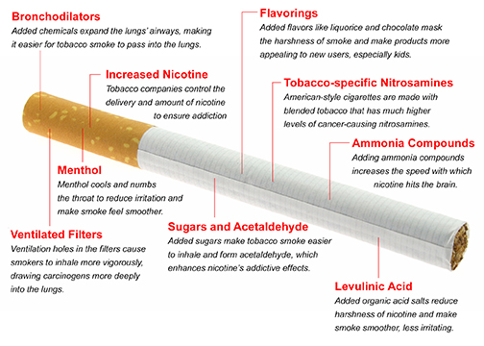


What’s in a cigarette?
Both vapes and cigarettes contain nicotine. While nicotine gets a person hooked on either a cigarette or a vape, it’s the thousands of other chemicals in tobacco smoke including tar and carbon monoxide that cause the most harm from smoking and make smoking more harmful than vaping to lungs.
Write in your book: Vapes and cigarettes both have nicotine, which can get you addicted.
But cigarettes are worse for your lungs because they have extra harmful chemicals like tar and carbon monoxide.
Notes:
Teacher: Read the slide and summarise the image of cigarette by saying that there are lots of chemicals in vape aerosol and cigarettes, cigarettes contain chemicals that can cause cancer, which is why cigarettes are more harmful than vapes. But vapes are not harmless.

Slide 18
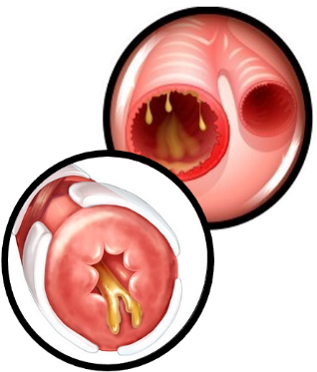
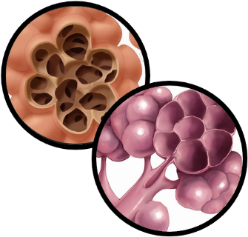
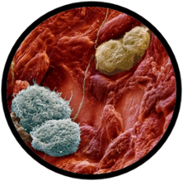
Vaping can hurt your lungs
Inflammation and irritation of the airways
Destruction of air sacs
in the lungs
Weaker immune response to infection
Your lungs help you breathe by bringing in oxygen and getting rid of carbon dioxide.
Vaping can irritate your airways, making it harder to breathe.
It can cause coughing and shortness of breath.
It might lead to bronchitis (lots of coughing and thick mucus).
Long-term vaping can damage your lungs and cause diseases like emphysema.
Notes:
Teacher:
-First, let's discuss how vapes and their chemicals hurt your lungs. Healthy lungs bring in fresh oxygen and push out carbon dioxide through your airways. When you vape, it causes swelling and irritation of the airways, this can make it harder to breathe. This can lead to coughing and shortness of breath. It can also lead to bronchitis (an illness that causes constant coughing which makes the mucus (snot) thick in your lungs) and long-term use can lead to emphysema, a disease that makes is hard to breathe.

Slide 19

Vaping and using tobacco products lead to serious consequences
We are also concerned about vaping and you getting COVID or EVALI (e-cigarette and vaping associated lung injury).
Lungs are weakened from breathing in smoke or aerosol.
Coronavirus attacks the lungs. So, there is concern that weakened lungs are at greater risk for getting COVID including getting a more severe infection, and other lung infections.
Write in your book: Vaping can make it hard to breathe and lead to short-term and long-term respiratory illness.
Notes:
Teacher: Read slide

Slide 20
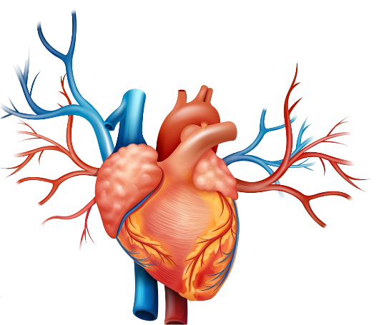
Vaping can hurt your heart
Risk for Blood Clotting
Your heart pumps blood to your whole body through blood vessels. That blood carries oxygen your cells need to stay healthy and work properly.
Vaping can make your blood vessels stiff.
This makes it harder for your heart to send oxygen to your brain, muscles, and organs.
Over time, it can raise your risk of heart problems like heart attacks or heart disease.
Stiff blood vessels
Write in your book:
Vaping can make it harder for your heart to send oxygen to your brain, muscles, and organs. Over time, this can lead to heart problems.
Notes:
Teacher:
-Let’s now discuss the heart health effects of vapes. The evidence that vapes increase heart risk is piling up.
-The heart is the centre for pumping blood throughout a complex network of blood vessels in the body. These blood vessels are responsible for delivering fresh oxygen to organs or tissues.
-Your cells need oxygen to survive and work properly.
-Breathing in the aerosol from vapes can lead to blood vessel stiffness and possibly affect your heart’s ability to move fresh oxygen to your brain, muscles, liver, and other parts of your body.
-Ultimately, blood vessel stiffness and blood clotting can increase someone’s risk for heart attack or heart disease.

Slide 21

Vaping can also give you acid reflux, heartburn, and diarrhoea!
💩
Notes:
Talking Points:
-There is also evidence that vaping can give you acid reflux, heartburn, and diarrhoea.

Slide 22



So why might some adults choose to vape instead of smoke?
Vapes can help adults stop smoking.
Most vapes, like cigarettes
Give smokers the same feeling as smoking
Do not contain tar and many of the chemicals in cigarettes like carbon monoxide that can cause cancer.
So, for a nicotine-addicted smoker trying to quit, a vape is a less harmful but not harmless way to use nicotine.
Notes:
Teacher:
Read the slide

Slide 23


Risk goes down immediately after you
stop vaping or smoking!
Notes:
Teacher:
-On the bright side, health risks decrease as soon as you stop using vapes.
-For example, the risk of having a heart attack can drop immediately after quitting vaping.
-Someone could act right away to protect their health by stopping smoking or vaping.

Slide 24





Extension activity: What problems do you think can come from addictions?
In friendships?
With family?
In school?
In mental health?
Financially?
Notes:
Teacher:
(Ask the class): What problems do you think can come from addictions? (pause for responses). Or you could do a ‘think-pair-share’ activity.
(Some examples may be: hard to focus in school; parents and teachers mad and upset; losing friends; dropping grades; feeling lonely, sad, stressed; letting friends down, worse at sports).

Slide 25


Key Takeaways
Vapes are NOT just harmless flavored water vapor. They produce an aerosol full of harmful chemicals and other elements.
An adolescent's brain is very vulnerable to drugs
Vape aerosol damages the lungs and heart, which can lead to disease.
Nicotine hooks you and makes your brain think you need it
5
The flavours and flavorings in vapes are also harmful. The risk of having a heart attack decreases right away when going vape-free.
…
6
Going smoke or vape-free allows the body to heal right away.
Notes:
Teacher
-Ask six students to each read one takeaway:

