Slide 1


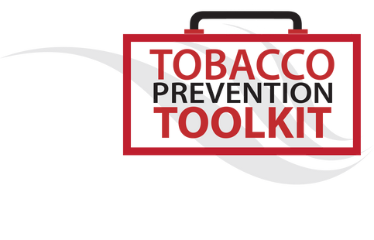
Lesson 2: Don’t be fooled

Slide 2



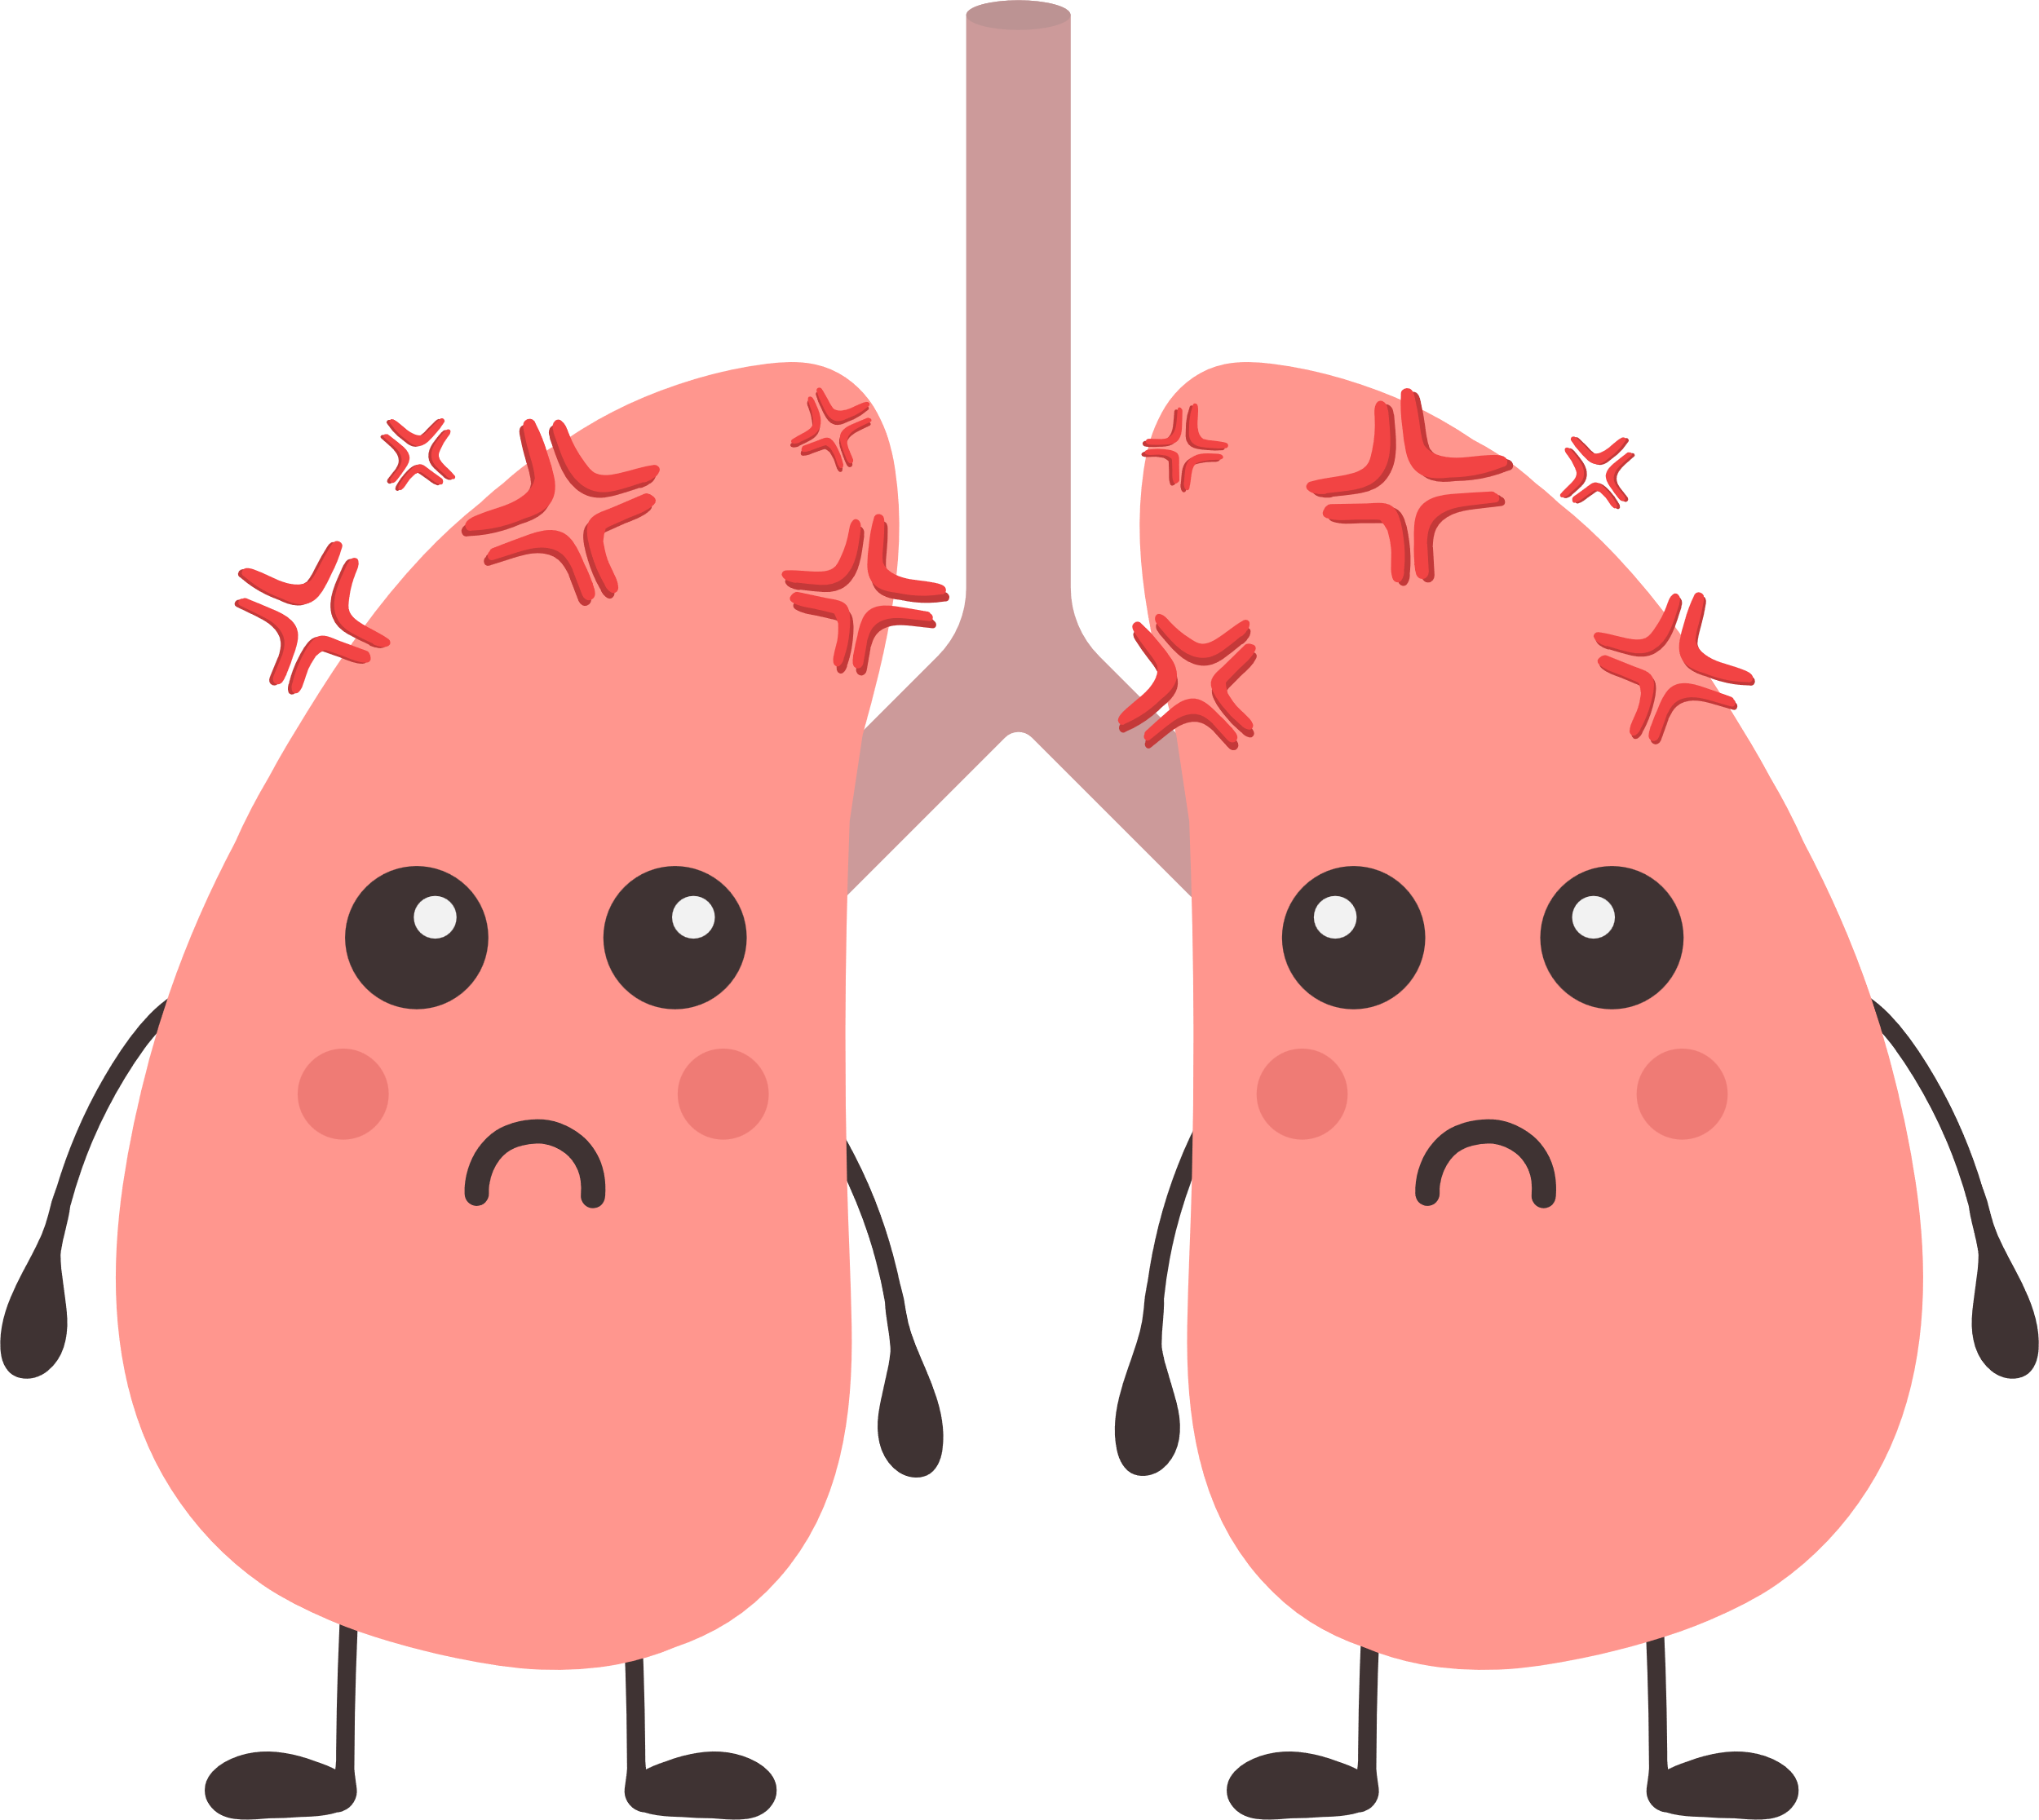


Re-cap from last lesson
An adolescent's brain is very vulnerable to drugs.
Nicotine hooks you and makes your brain think you need it.
Vapes are NOT just harmless flavored water vapor. They produce an aerosol full of harmful chemicals and other elements.
Vape aerosol damages the lungs and heart, which can lead to disease.
The flavorings in vapes are also harmful.
Going smoke or vape-free allows the body to heal right away.
Notes:
Teacher: Read slide

Slide 3
Topics
  Refusal skills
  How to decode marketing tactics
  Methods to refuse marketing from tobacco and vape companies
Notes:
Teacher: Read slide

Slide 4



Starter activity: Think-Pair-Share/class discussion
Even with the health concerns we covered last time, why do you think some people your age vape?
Notes:
Teacher Note: This can be a ‘think-pair-share’ activity or a class discussion.

Slide 5



Why do you think people your age DON’T vape?
Notes:
-(Teacher Note): Allow for discussion between students. Might get answers like, ‘because its illegal’, ‘don’t like the taste’, ‘nicotine is addictive’, sport and fitness reasons, expensive, no one knows the long-term effects yet, can contain things like THC and spice,
Use the question below to facilitate discussion if desired.
-Q: Do you think there is a stigma against people your age who vape?

Slide 6




You can refuse!
Here are a few ways to refuse
1
Assertively refuse with or without a reason.
‘No, I’m not interested.’
‘No, it’s makes it hard for me to breathe.’
2
Use humour to change the subject/distract from the situation.
‘I’d rather keep my lungs match-fit – what if England call me up next week? ANYWAY, did you see the match last night?’
3
Use an excuse to avoid vaping.
‘No chance, I have a headache already – I don’t want to make it worse’.
4
Tell a ‘white lie’
‘Nah, I already tried one off my cousin and it made me feel sick.’
Notes:
Teacher: Let's think about how to respond to someone who wants you to vape with them.

Slide 7
Activity: Refusal skills
1
At a friend’s house
You’re at your friend’s house and they find their dad’s vape. They’re thinking about trying it and want you to try it with them.
Instructions:
Talk about how each of you would respond to the offer in one or two of the four scenes.
Create different ways people would respond to the offer in that situation. Keep in mind where you are and who is there.
You can present the conversations through a 1–2-minute skit or tell the class your group’s ideas for how to refuse.
2
On a school trip
You are on a school trip. A group of friends suggests that you all sneak off for a vape. There are adults around, but they don’t know that one of the friends has a nicotine product.
3
At school
You are school and one of your classmates says a few people are going to go the toilets together to try a vape someone brought. They tell you to come along.
Use different ways to refuse:
Using humour
Telling a ‘white lie’
Using an excuse
Assertively refusing with or without a reason
At a park
4
You are at the park. You are sitting with a small group of mainly new friends, some older than you. One of these new friends pulls out a vape/cigarette/or any other nicotine product and asks if anyone wants to try it.
Notes:
Teacher note: Students can present the conversations through a 1–2-minute skit or tell the class their group’s ideas for how to refuse.

Slide 8
ACTIVITY: REFUSAL SKILLS
Write in your book two ways you can refuse offers to vape:
If I am offered a vape, I will______________________________.
If I am offered a vape, I can also _________________________.
Use different ways to refuse:
Using humour
Telling a ‘white lie’
Using an excuse
Assertively refusing with or without a reason
Walking away
Be realistic and think of your own personality! For example, if you’re unlikely to use humour, think of something you would really say and/or do.
Notes:
Teacher: Have students create their own approaches to refusal.

Slide 9


Ok, we now have personalised ways to refuse offers to vape. This is important as young people may be offered vapes and need to be prepared to refuse. But it’s not just people around us that influence us to vape. Let’s now look at how tobacco and vape companies try to get young people addicted to their products.
HAIR SPRAY
Notes:
Teacher: Read slide

Slide 10

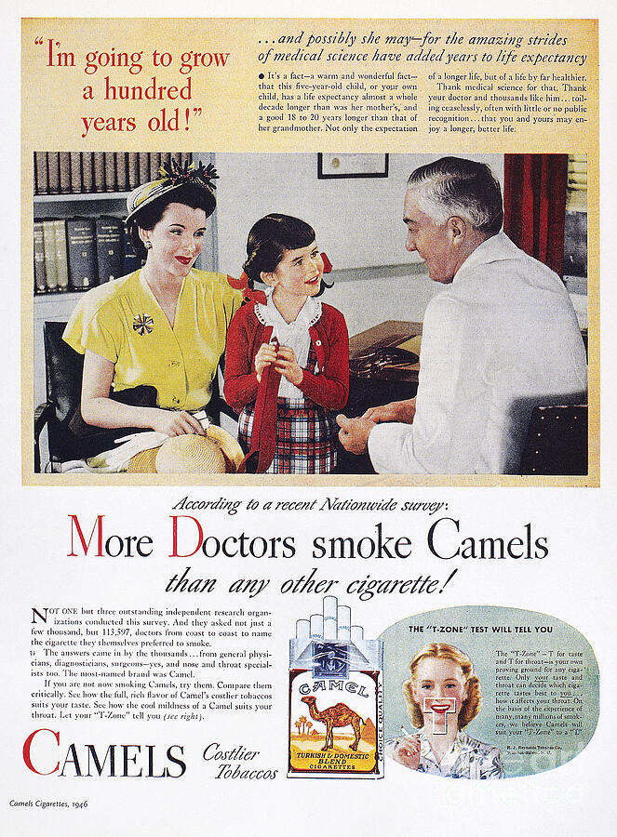
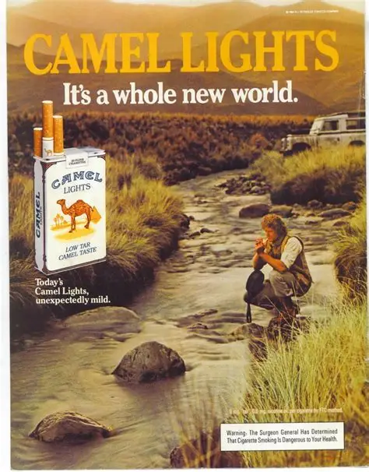
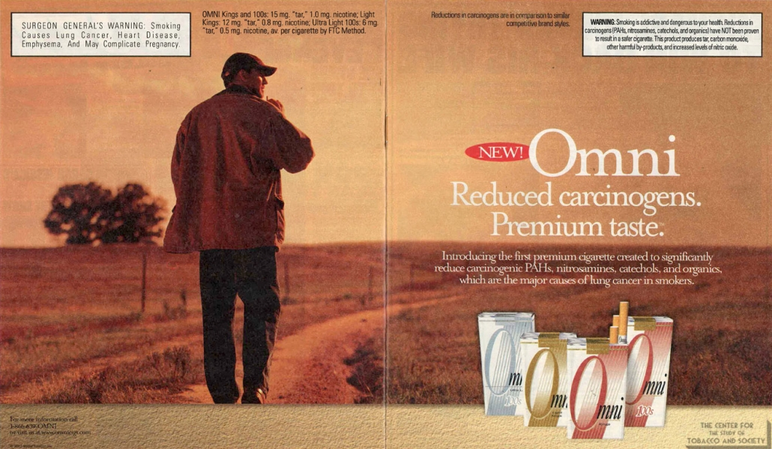

Totally False Tobacco Ads
Pretending to be "Safe"
1940s
Early 1980s
Early 2000s
2010s
Write in your book: Historically, tobacco companies used false advertising to sell cigarettes, even after evidence showed that smoking causes serious health problems.
*carcinogens = substances that cause cancer
Cigarettes became popular in the 1880s, but people didn’t know they were harmful.
It wasn’t until the 1950s that smoking was linked to cancer and heart disease.
For years, tobacco ads gave false messages—some even claimed doctors recommended smoking!
Tobacco companies (aka ‘Big Tobacco’) made huge profits and didn’t want to lose customers, so they kept pretending cigarettes were safe.
They started targeting ads to specific groups, using themes like adventure to make smoking look cool—even though it was dangerous.
Notes:
Teacher: (Read slide)

Slide 11
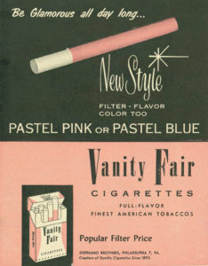
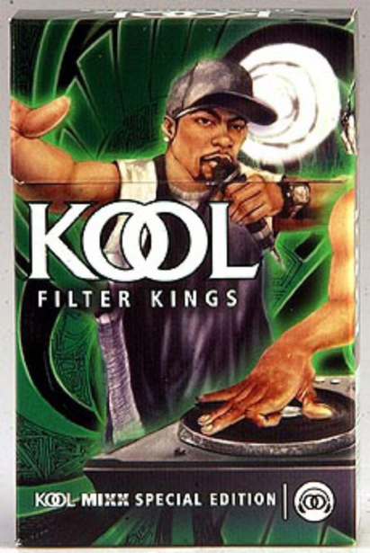
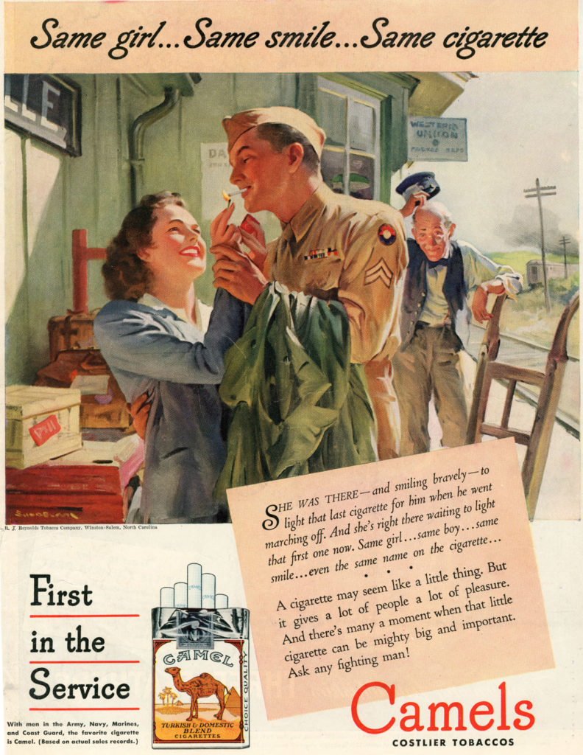

Targeted ads: Soldiers, women, black community
Big Tobacco companies expanded their marketing tactics through targeting certain groups.
Targeting groups means making specific ads that will attract people from that group.
For example, tobacco companies promoted cigarettes to soldiers, women, and black communities.
Write in your book: Historically, tobacco companies used false advertising to sell cigarettes, even after evidence showed that smoking causes serious health problems. They also target certain groups of people.
Notes:
Teacher: Read slide

Slide 12
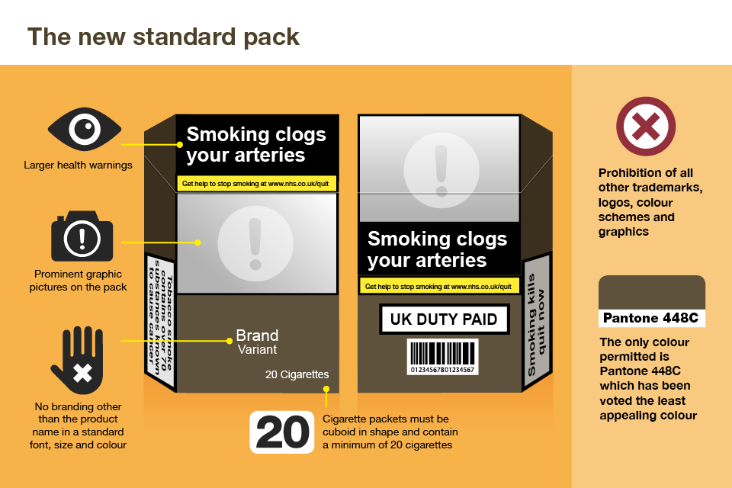
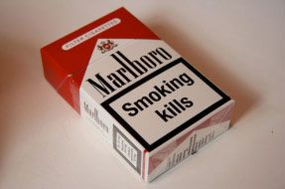
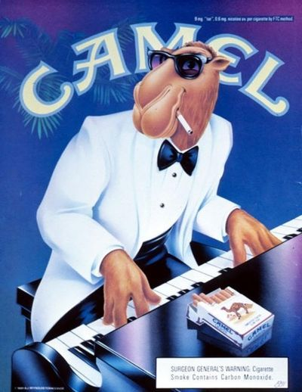

Tobacco ads in the UK
From 1971-early 2000s, the UK government has continued to pass laws requiring clear health warnings on tobacco products. Tobacco ads were banned in 2002.
In 2016 the UK passed a law that tobacco companies were no longer allowed to use colourful, glamorous, or stylish packaging.
Write in your book: Tobacco ads were banned in the UK in 2002. In 2016, colourful or stylish packaging of tobacco products was no longer allowed.
Notes:
Teacher:
-Eventually, the government made tobacco companies print warning labels on their products so that people would know about the dangers of tobacco and nicotine because so many people were becoming addicted, getting sick, and dying from cigarette smoking. The government has continued to make laws that make tobacco companies have to be more honest about what they’re selling and stop them from using attractive ads and packaging. (Read notes on slide)

Slide 13


The history of tobacco and smoking leads up to today...
It’s important to know about the history of tobacco and smoking because it all leads us to today.
Today there are new products, like vapes, that have become popular, especially with young people.
Notes:
Teacher: Read slide

Slide 14


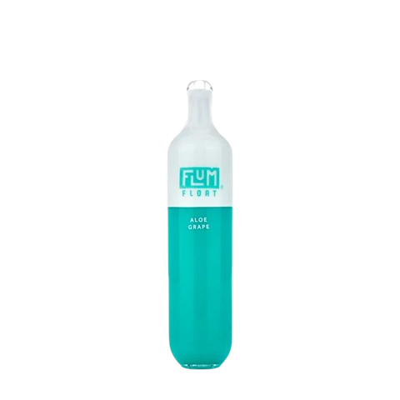





Cigarettes Vapes
Vapes
Very addictive &
high in nicotine!!
Tobacco companies have shifted into creating different products so that they can continue to make money by getting people addicted to their products.
Many companies that sell cigarettes now also sell vapes.
The tobacco industry uses the same tricks to attract new and young customers.
Notes:
Teacher: Read slide

Slide 15
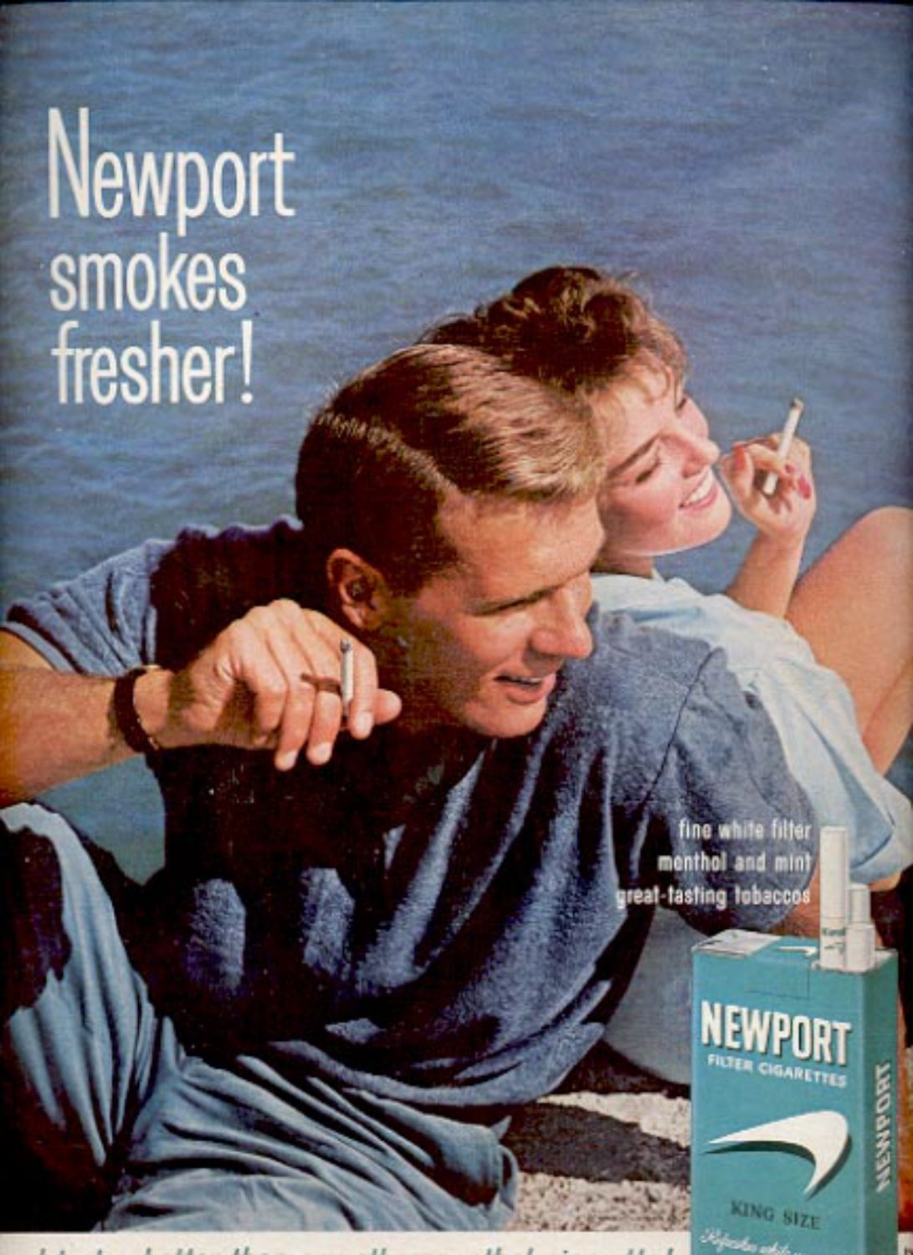

Strategies and tactics tobacco and vape companies use
Strategy is the action plan that takes you where you want to go.
The tactics are the steps and actions that will get you there.
Just like ads for cigarettes, tobacco and vape companies use tactics like emotional appeal, celebrity endorsements, cartoons, and animation on social platforms to appeal to youth.
Vape companies also encourage their followers to share and interact with their content on social media.
This ultimately leads to people purchasing their products.
Let’s break this down a bit further!
1990s cigarette ad
2019 vape ad
Notes:
Teacher: Read slide

Slide 16

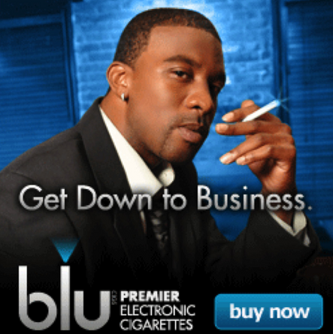
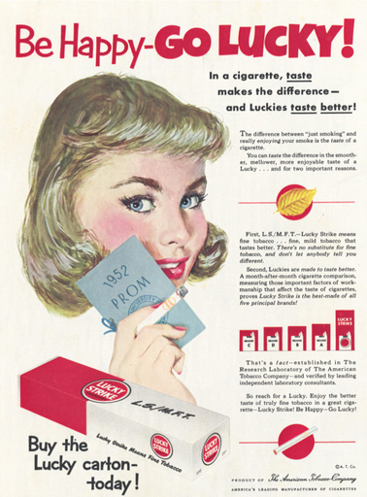


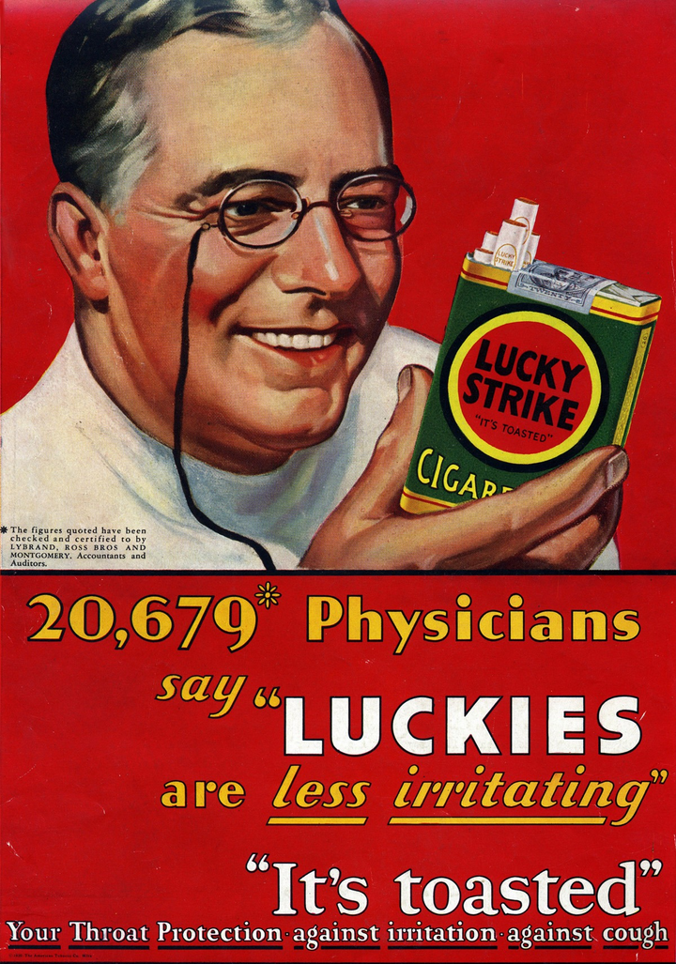

Vapes & same ad tactics
TARGETED ADS:
USE INFLUCENERS
PRETEND TO BE HEALTHY
Tobacco and vape companies still target groups like teens, women, LGBTQ+, and people of different or mixed ethnic backgrounds. They use ads with celebrities and fun vibes to make vaping look cool and safe—just like they did with cigarettes. It’s the same old tricks.
Notes:
Teacher: Read slide

Slide 17
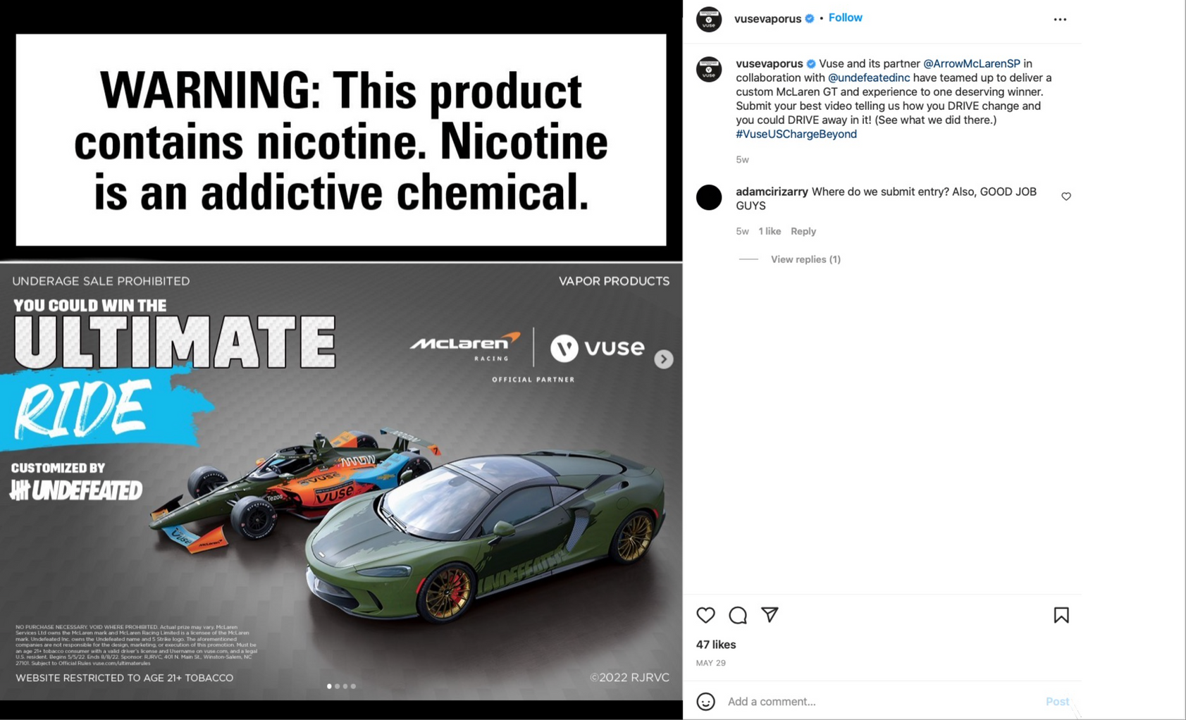

Vapes & same ad tactics
TARGETED ADS USE:
Tricks and smoke screen

Slide 18
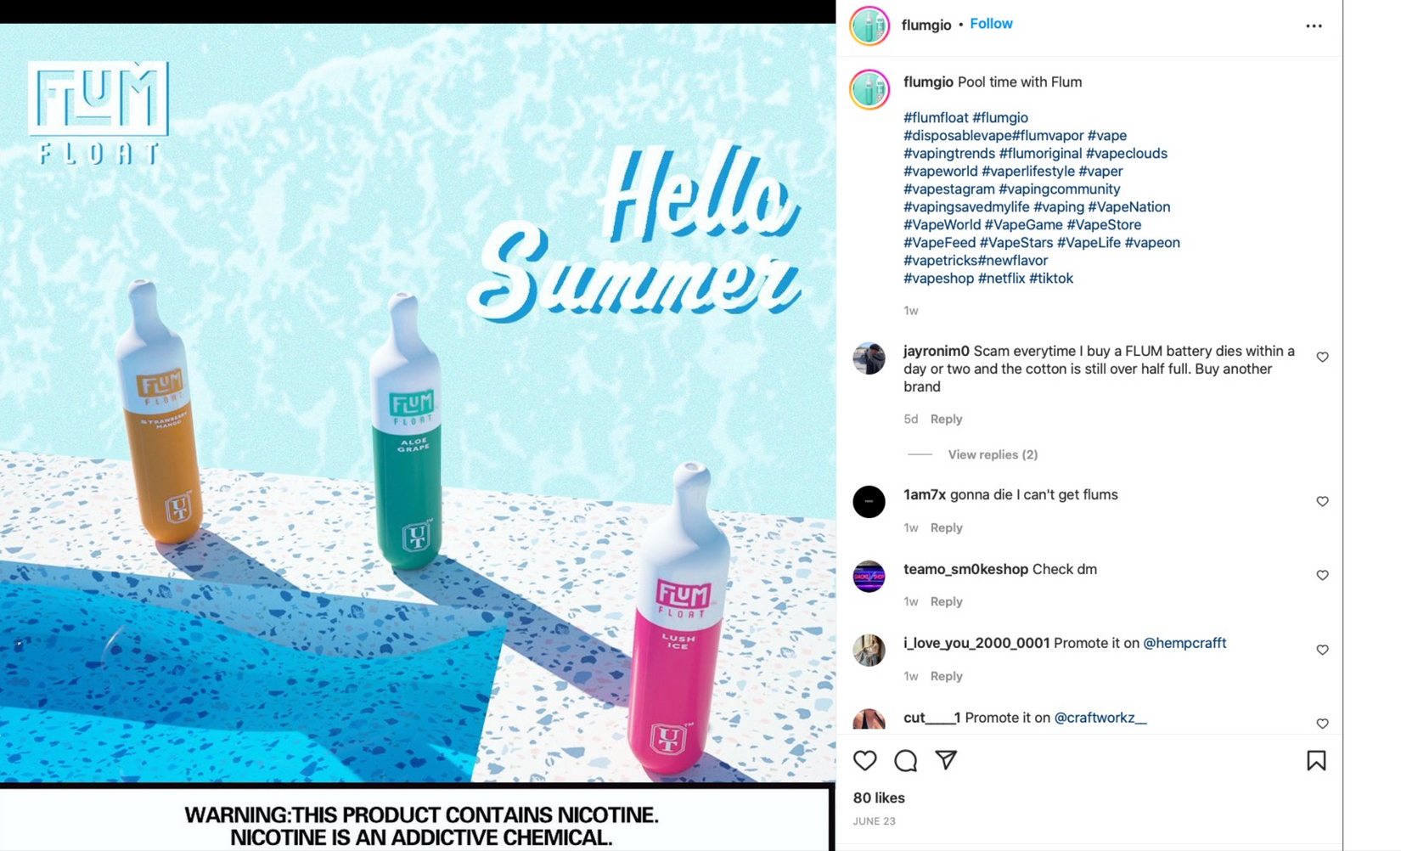

Vapes & same ad tactics
TARGETED ADS USE:
Messaging and flavouring

Slide 19
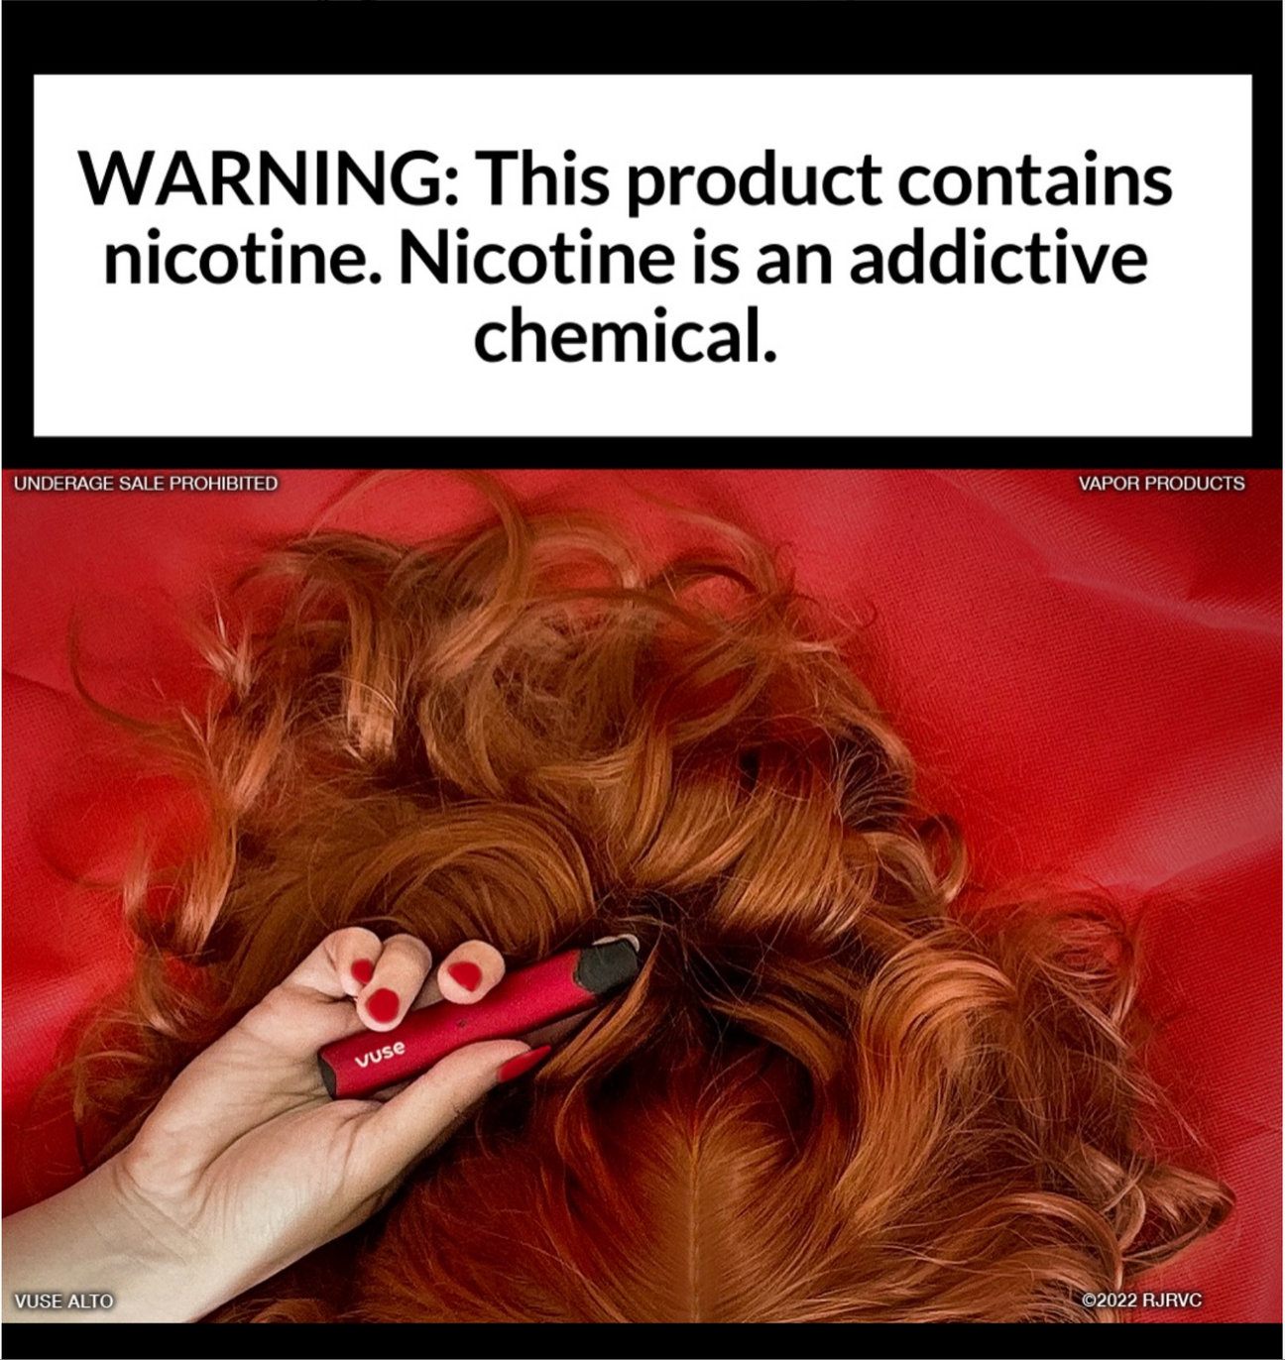
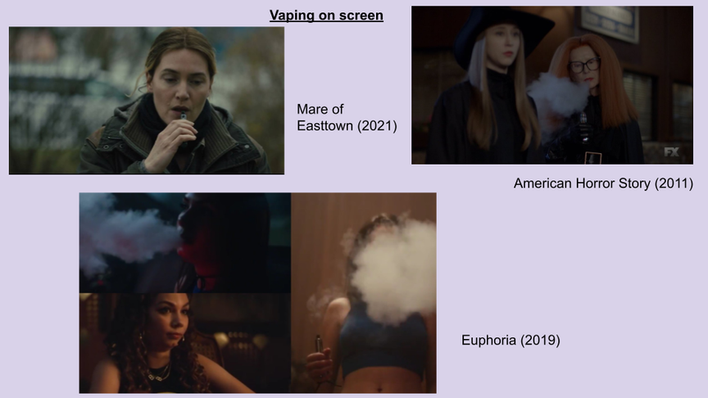

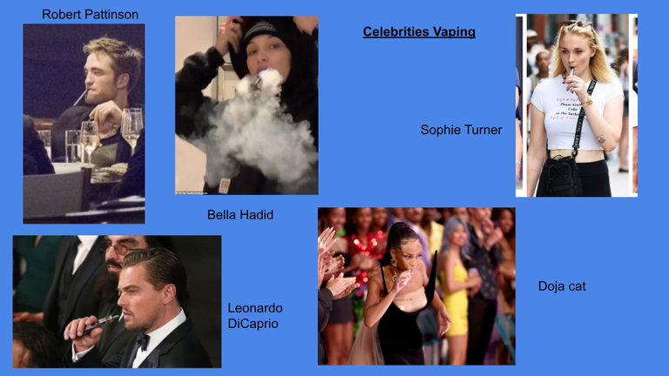
PRODUCT PLACEMENT
Vape companies sneak their products into ads so they don’t look like ads. This tricks your brain into noticing the product without thinking about it. Some young people don’t even realize they’re being advertised to.
Notes:
Teacher: Read slide

Slide 20
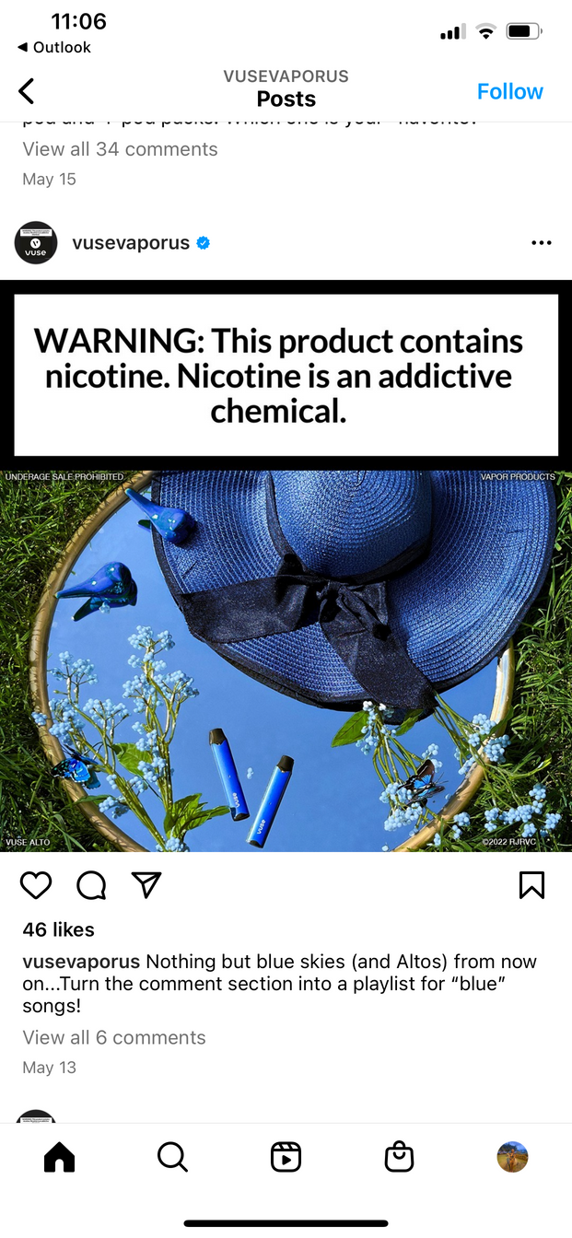


COLOUR SCHEME
Vape ads use bright, fun colours to make you feel good about the product. Tobacco companies know these colours can create emotional connections, which makes it easier for young people to get hooked.
Notes:
Teacher: Read slide

Slide 21
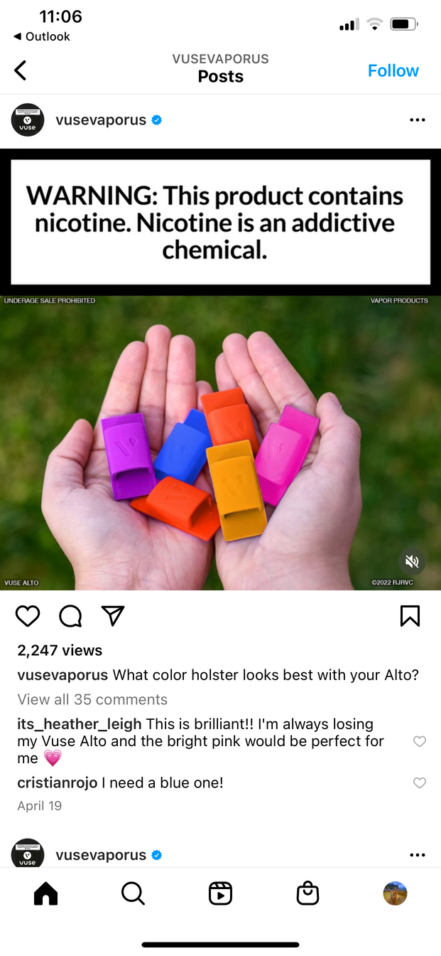
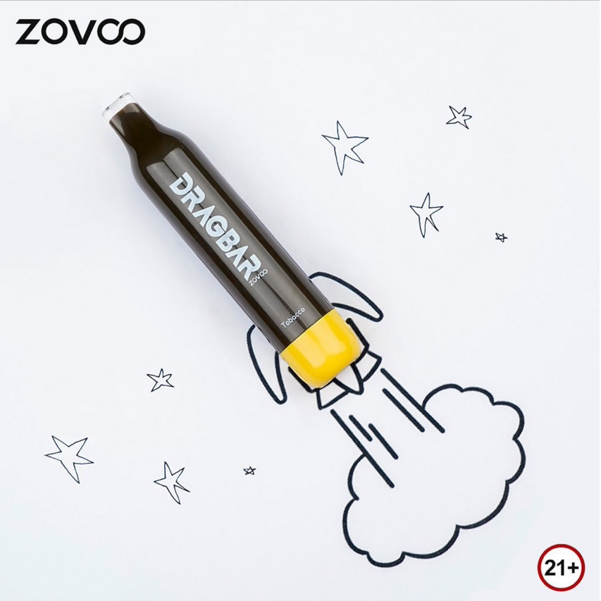
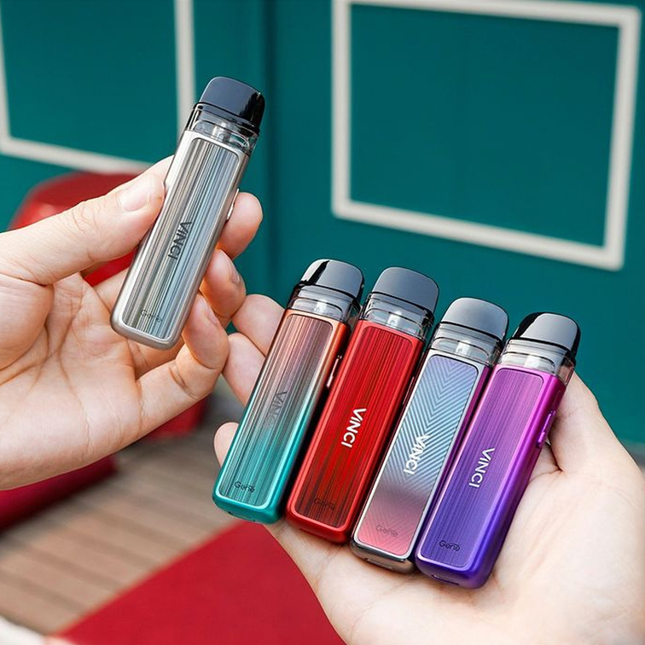
SHAPES
Vape ads use cool shapes and bright colours to grab attention. They don’t say much—just links to buy—so curious teens might click without thinking. It’s a sneaky way to get young people interested and buying.
Notes:
Teacher: Read slide

Slide 22

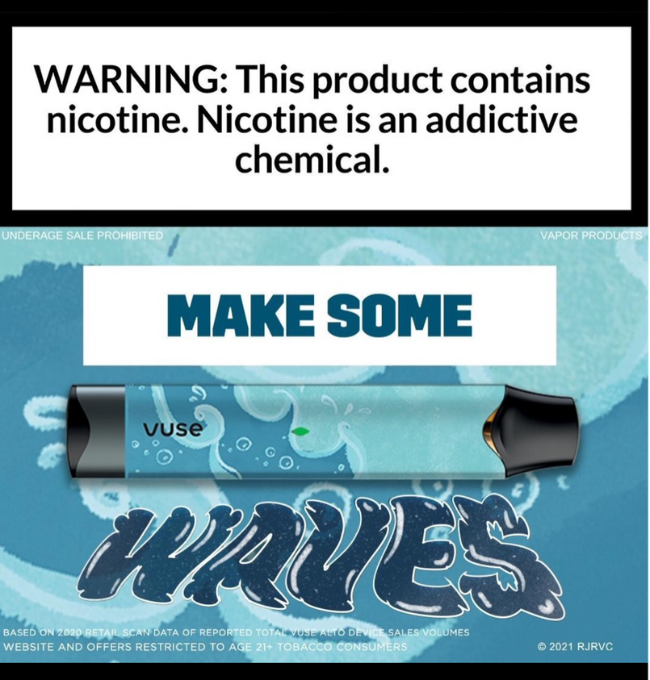
MESSAGING AND FONTS
Vape ads use bold, big fonts and short messages to grab your attention fast.
They’re made so you remember the idea without really thinking about it. It’s a trick to make vaping seem cool without showing the risks.
Notes:
Teacher: Read slide

Slide 23
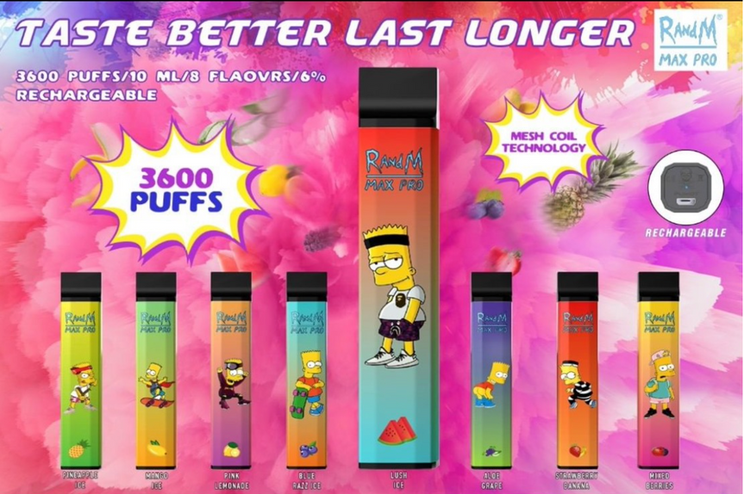


MESSAGING AND FLAVORS
Vape ads with fun flavours like gummy bear or mango make vaping seem harmless, but it’s a trick.
These ads make smoking look normal again, and that can lead more kids to start. Tobacco companies know flavours help hook young people.
Notes:
Teacher: Read slide

Slide 24
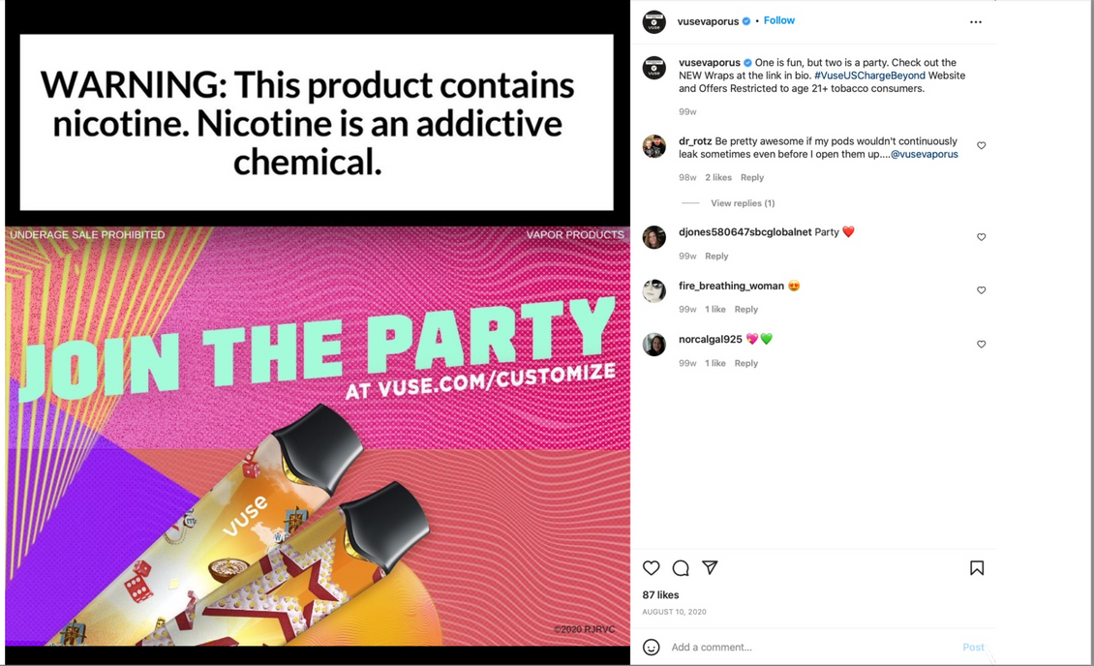



Misleading messaging
Vape companies use misleading messages to make vaping seem safe and fun, even though it’s harmful and addictive.
Notes:
Teacher: Read slide

Slide 25
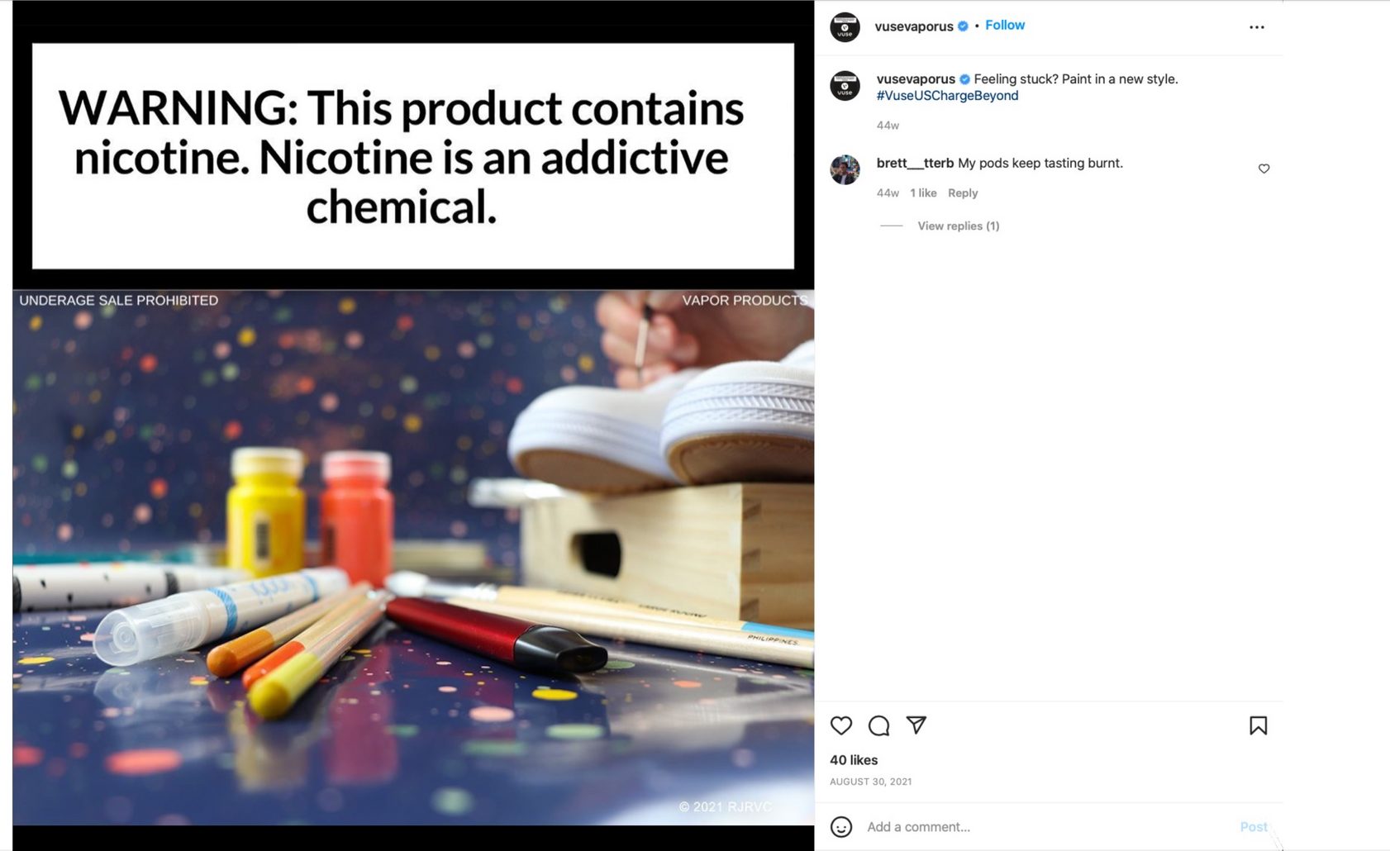

Vapes & same ad tactics
Who do you think the industry targeting here?
Notes:
Talking Points:
-These tobacco companies spend millions of dollars on designing marketing strategies and products to be very easy to get hooked on.
-Now we are going to talk about the ways tobacco companies use the same marketing tactics used in cigarette ads to attract and hook new young consumers to e-cigarettes.

Slide 26

Decoding marketing messaging
Vape ads try to make vaping look cool, but they’re just tricks from tobacco companies to get kids and teens hooked.
Learning how these ads work helps you see through the lies and make smarter choices.
£
Notes:
Teacher: Read slide

Slide 27




Using social media to grab teens
Vape companies have found huge success in social media marketing on TikTok and Instagram.
Most young people are on social media, and almost all teens use the internet daily.
The tobacco and vape industries know exactly what strategies to use and will find and target new young consumers to get them addicted to their products, including advertising on social media.
The tobacco industry uses social media to grab teens' attention so they can maximize sales and keep a competitive service.
Write in your book: Tobacco and vaping companies use product placement, colour schemes, messaging, fonts, and flavours to target new young consumers to get them addicted to their products, including advertising on social media.
Notes:
Teacher: Read slide

Slide 28

TOBACCO & MEDIA
How can we protect ourselves from being influenced by ads like these?
Notes:
Teacher (Click to play video – has sound- just music). Read slide.

Slide 29





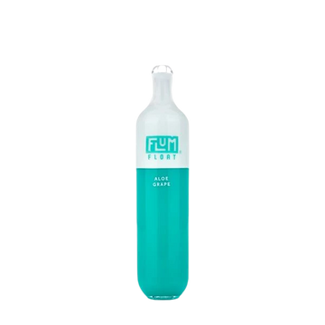


New ways to make money
The vaping industry spends millions of pounds to get young people like you addicted to their products.
They do not care about you; they just want to make money.
So, it's important to understand these manipulative tactics to resist the marketing influences from vape companies.
VAPE COMPANIES
Write in your book: Tobacco and vaping companies spend a lot of money to get young people addicted to their products.
Notes:
Teacher:
The vaping industry spends millions of pounds to get young people like you addicted to their products.
-In reality, they do not care about you, they just want to make money.
-So, it's important to understand these manipulative tactics to resist the marketing influences from e-cigarette companies.

Slide 30



ACTIVITY: DE/RECONSTRUCT ADS
In your groups, think of the ad you have been given. What if it had to be 110% honest about what it is selling?
Think about
Who paid for the ad?
Who are they targeting with the ad and why?
How did they make the ad appealing?
What would be an honest slogan for the ad?
Rewrite the ad based on your new 110% honest slogan.
£££

Slide 31


Key takeaways
The tobacco industry is using the same marketing tactics as before to hook new young consumers on vapes.
Write in your book:
Something from the lesson that made you feel more confident
An interesting fact you learned
A reflection on how your opinion on vaping has changed, and if not, why not
1
2
Nicotine vape companies use the same eye-catching advertisements and marketing tricks to appeal to a young audience.
3
The tobacco industry uses sneaky messaging in ads and flavored vapes to get young consumers hooked on the nicotine in vapes.
Notes:
Talking Points:

