Slide 1




Growing up in North Yorkshire survey (Health and WELLBEING)
A survey for young people in 2024
Schools and Students Health Education Unit, Exeter
Notes:
This presentation is for pupils who will be completing the Growing Up in North Yorkshire Survey 2024 – it could be shown in assembly, before the pupils start the questionnaire or before break and then they complete the questionnaire after the break . The aim of the powerpoint is to ensure that a safe, secure and positive learning environment is created so the pupils feel able to complete the questionnaire honestly and accurately which will then provide your school with a good source of data.
Pupils should complete their own survey without talking to other pupils (exam type conditions) and the survey should never be set to complete at home.

Slide 2
WHAT IS THE SURVEY ALL ABOUT ?
In North Yorkshire the survey has been done with Year 2, Year 6, Year 8 , Year 10 and Year 12 pupils since 2006
THANK YOU if you have previously done the survey – the information you gave us has been so useful for your school but also for the County Council in their planning to look after you and other people your age
The survey is about: your health, your safety, how you are feeling, and
learning at school
In North Yorkshire in 2022 17, 000 children and young people took part
Notes:
The survey has been running since 2006 so some pupils may have completed it before as it is done with Year 2, 6, 8 and 10 and this year Y12 – so please thank pupils if they have completed it. In North Yorkshire the survey runs ever two years.

Slide 3
What happens with the information?
We find out some important things about young people at a school level, district level and the whole of North Yorkshire
Schools and other services who work with children and young people then work hard to respond to the issues raised by all the pupils who have taken part. Some examples that are a direct result of the data collected by the questionnaire :
          Increased the support for young people to help with emotional health and wellbeing / mental health issues
          Increased support on healthy lifestyles
          Support on careers and next steps in education
Notes:
The data from the surveys is collected from all the pupils in North Yorkshire and used at a County level e.g to inform the children and young peoples plan , ‘Young and Yorkshire’, as well as district data and then your individual school data– if possible give a good example of something that has changed due to the data your school got in 2022 or you could use the examples on the slide.

Slide 4
Privacy?
No one will find out your answers
You don’t put your name anywhere on the questionnaire
All questionnaires are private and once you have finished they will not be read by anyone connected with the school.
The school gets only the overall percentages, not individual answers (so, we might find out that 5% of pupils eat chips every day – but we won’t know who)
All the completed paper questionnaires will be destroyed not kept
The results will be kept safe by the research team.
If you want to talk to someone about anything in the survey, please speak to an adult in school or at home who you feel comfortable with
Notes:
It is really important that pupils feel safe and comfortable completing the questionnaire and that they are made aware that no one will see their answers and that they do not write their name on the questionnaire. BUT please do emphasise to pupils that because there is no name on the questionnaire if they ask for help in writing on the questionnaire in response to a question then an adult in the school will not see this – if the questionnaire raises any issues for the pupils then they must TALK to an adult they trust in school.

Slide 5

3 minute clip on the pupil privacy notice
https://sheu.org.uk/content/pupil-privacy-notice-video
If you want to talk to someone about anything in the survey, please speak to an adult in school or at home who you feel comfortable with
Notes:
This short clip shows how SHEU (the organisation that run the survey on behalf of North Yorkshire County Council ) manages the data so it is kept safe at all times. You will need to consider how this information is provided to pupils who may find it difficult to access the writing on the presentation.
https://sheu.org.uk/content/pupil-privacy-notice-video

Slide 6

How DO I take part?
Some schools do it online, some on paper
Do I have to take part?
We hope you will want to take part and enjoy answering the questions but you can leave out any question that you don't want to answer
If you do not want to take part in this study at all, please let a member of staff know.
If you want to talk to someone about anything in the survey, please speak to an adult in school or at home who you feel comfortable with
Notes:
Please clarify for the pupils if the school will be asking the pupils to complete the questionnaire online or on paper and explain how that will work. Please also clarify that they can leave any questions out that they don’t want to answer.

Slide 7
More about taking part…
It is really important that the information collected must be accurate; therefore we want only your honest answers.
        For example, if you did not wash your hair yesterday, even though you normally do every day, please tell us the true answer for yesterday.
The questionnaire is not a test and you can ask for help whenever you need it (put your hand up as usual). There is a practice page so you can have a go at the different types of questions – after doing the practice page this would also be a good opportunity to ask any questions.
If you make a mistake, just correct it - the research team will make sense of it.
If you want to talk to someone about anything in the survey, please speak to an adult in school or at home who you feel comfortable with
Notes:
The emphasis must be on them giving honest answers to the questions that are being asked – please expand on the hair washing example provided. Explain it is not a test – that they can put their hand up and ask questions. It might be a good idea after the practice page to just ask again if anyone has any questions before they start the full questionnaire.

Slide 8
THINGS TO WATCH FOR
      The survey will ask about young carers. We are not asking if you care about your parents, nor if you occasionally help out at home. Young carers are people under 18 who offer substantial, regular, help to a parent, grandparent, brother or sister who has a disability or mental health, drug or alcohol issues.
Your survey will ask about parents/carers in the armed forces. We are asking only about Mum, Dad and other guardians or carers in the home, not other family members or relatives, even if you are really proud of them. Not everyone will have a parent in the armed forces.
Your survey will ask for your postcode. The Council would find it really helpful to be able to draw maps of the results, so we would like as many full postcodes to be collected as possible. No-one will find out who you are or write to you at home. Your postcode will not be stored with the rest of your answers.
Notes:
Due to responses in previous years we would ask that you clarify for pupils that when asking if they are a young carer it is not whether they care about a family member but whether they care for them in specific ways - please emphasise the difference. Also for the armed services I am sure some pupils will have family members who they are very proud of in the armed services but this questionnaire is only asking about either their mum / dad or main carer not any other family members. We will ask pupils for their postcode – they perhaps need reminding of this before they complete the questionnaire or could there be a list available for them to copy from but again please explain to them that by putting the postcode down does not mean the answers will ever be matched to an individual or their home, it is so ‘areas’ of the county can be identified.

Slide 9
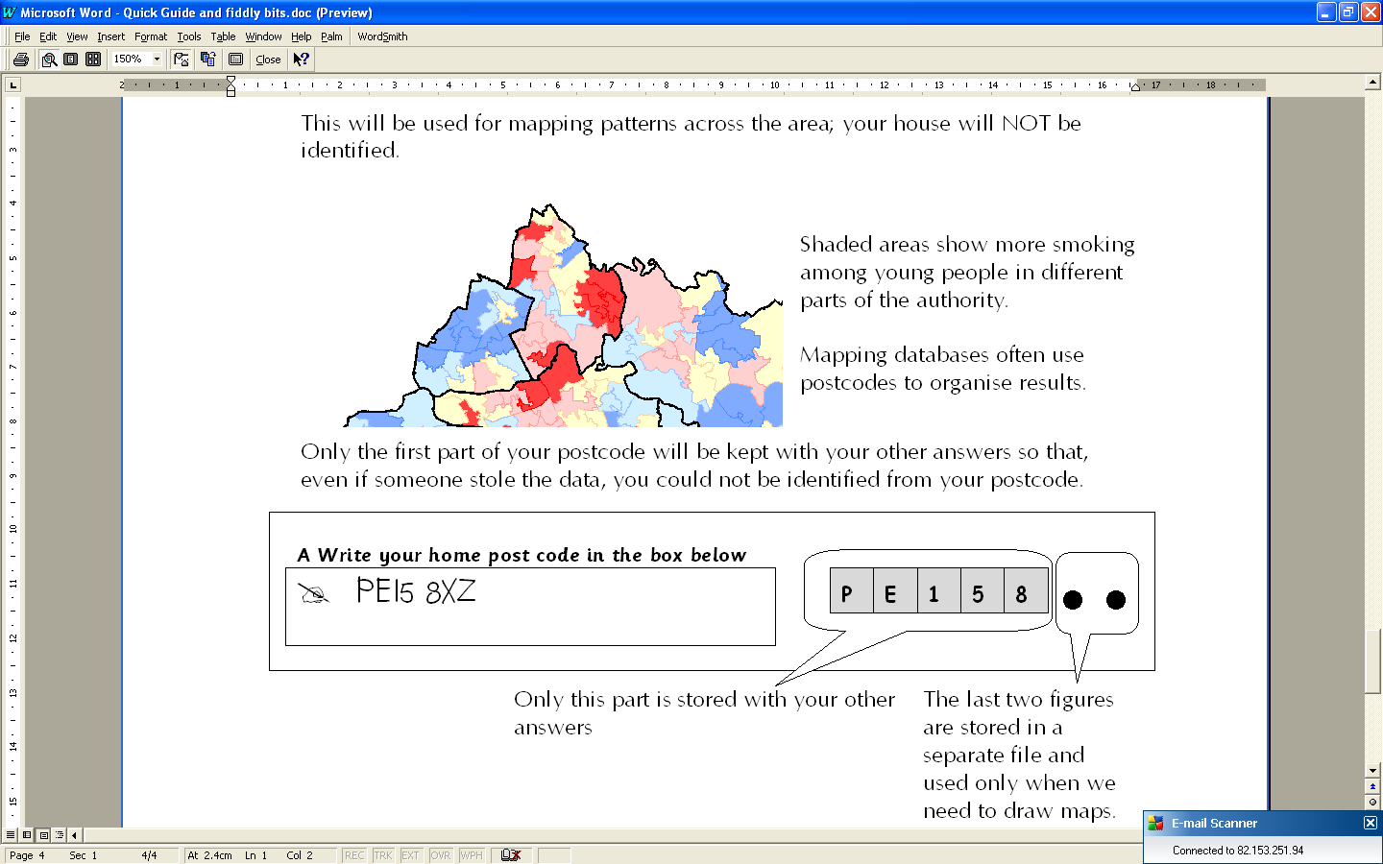
Pupil information about postcodes
Notes:
Further clarification on why postcode information is asked for so we can map responses against areas of the County. By providing the postcode no pupils will be identifiable

Slide 10
Thank you for taking part in the questionnaire
Please be honest with your answers as the school and North Yorkshire Council find the information so helpful to make improvements for children and young people
If you want to talk to someone about anything in the survey, please let an adult at school know
Notes:
Again thank them for taking part, remind them to be honest and that their responses will be confidential and that if they need to then they can speak to a trusted adult if the questionnaire raises any questions for them. If they get ‘stuck’ then they can put their hand up and speak to the member of staff.

