Slide 1
PRIVACY NOTICE Health and WELLBEING survey
A survey for young people
Schools and Students Health Education Unit, Exeter

Slide 2
1. Who are you?
We are a research unit in South-West England.
We have been asked by the school or the Council to help collect information from young people.
www.sheu.org.uk

Slide 3
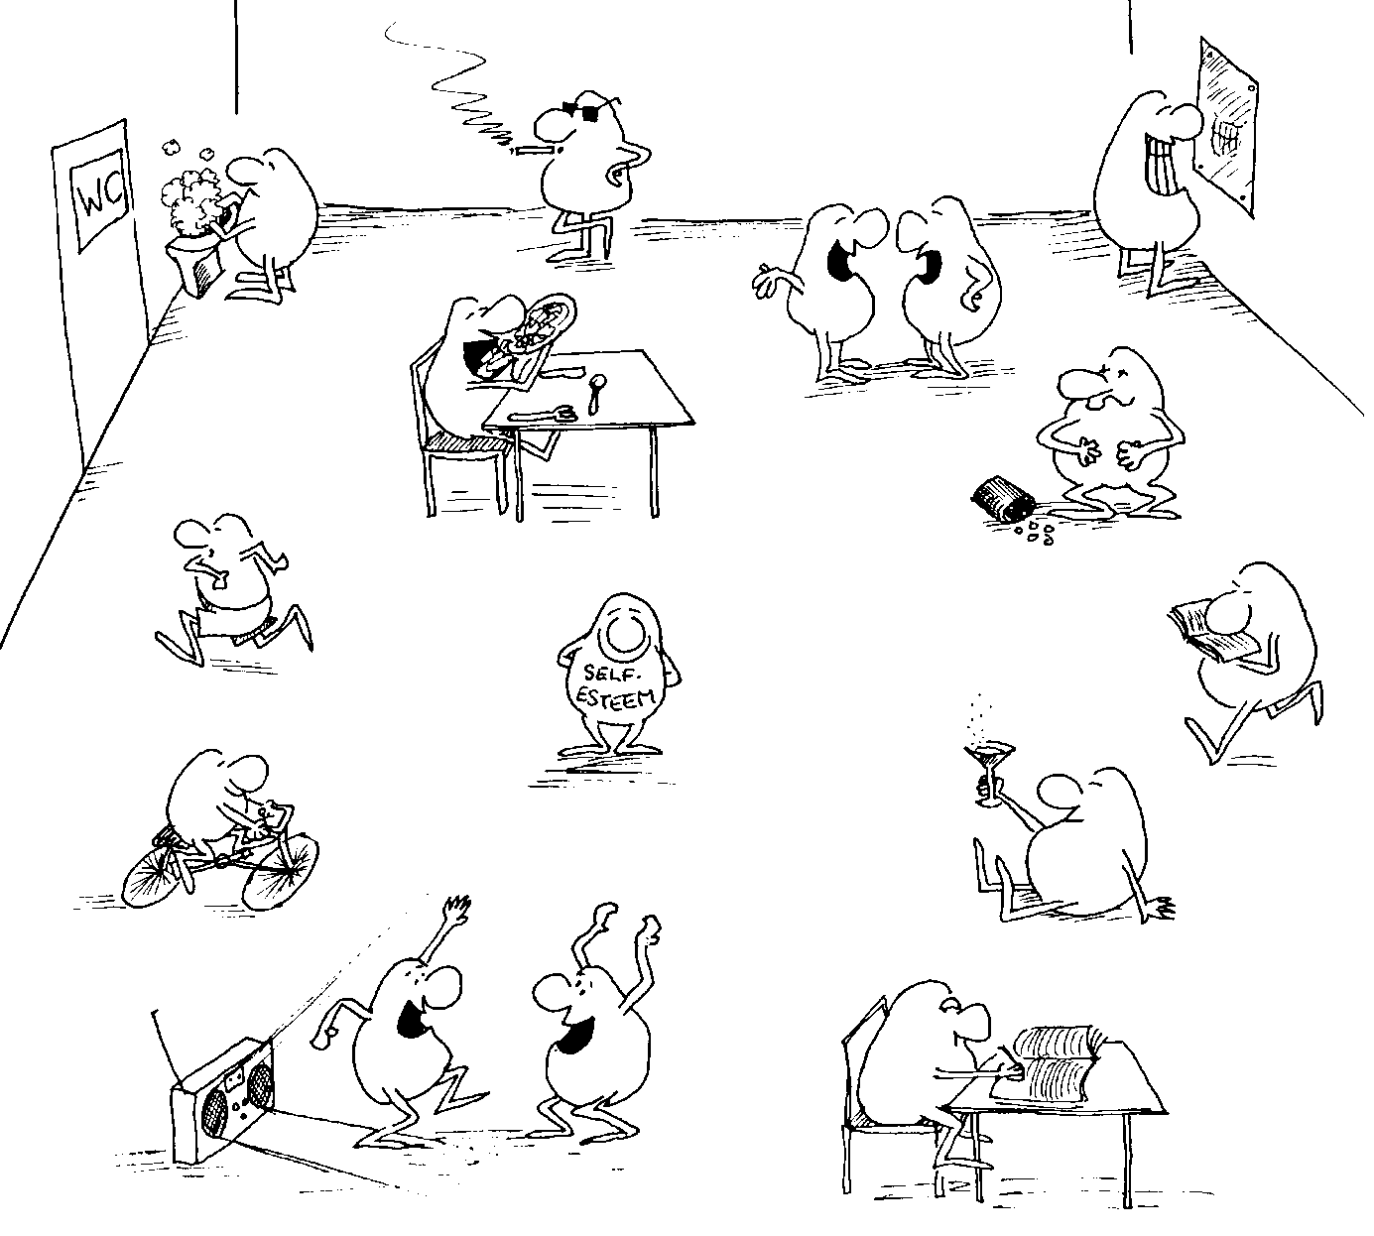
2. What will I be asked?
You will be asked about your habits and feelings, and other important things about you.
You will not be asked for your name or address, and please don't tell us!

Slide 4
3. Why do you want to know this?
The reports are used to plan lessons and services for young people, and to see what has changed since the last survey.
The school will see if your lessons fit in with what you and other young people tell us. They want to be sure what they are doing is right.

Slide 5
4. How will you use my information?

We will send reports to schools and the Council, showing them how many pupils gave different answers. The reports might say things like:
30% of pupils in this school had cereal for breakfast, but in the whole County the figure was 40%

Slide 6
5. How will you collect this information?

We are going to ask you questions in a questionnaire, on a website or in a printed booklet.


Slide 7
6. How do you keep this information?
Your answers will be kept safe on our computers.
We keep records for many years, so that we can see how young people's lives are changing.

Slide 8
7. Are you allowed to do this? (‘legal basis for processing’)

The Council is allowed to collect information to help it plan and monitor things it does to support young people's education, health and wellbeing – the sorts of things it has to do (‘legal functions’ and ‘public interest’).
SHEU is allowed to use information to produce its reports as long as no-one can tell what answers you gave (‘legitimate interests’).

Slide 9
8. Who gets to see the information?

Only staff from SHEU and from the Council who need to see the information to do their job are allowed to see your answers. They won’t show your answers to anyone else.
Everyone else sees only percentages. No-one in your school sees your answers.
BUT if you tell us something that makes us think you are in danger, we will have to tell your school that someone has said it, even if we can’t find out who you are.

Slide 10
9. What’s next?
☞
If you agree with all this, please tick the box at the start of the survey.
If not, don’t take part.
You can leave out any questions you don’t want to answer, and you can stop at any time.
Later, if you want to see what we know about you, you can ask us, and you can tell us to delete it.
But remember, we might not be able to find your answers because we don’t know your name.

