Slide 1
Climate Action Plan Guidance for Schools
Guidance for primary and secondary schools in York.
Created in collaboration with students from the University of York’s Sustainability Clinic.

Slide 2
Introduction
What is a climate action plan?
Why does it matter?
From 2025 onwards, the Department for Education Estate Management Standards include a requirement that schools have a sustainability lead and a climate action plan (CAP).
A climate action plan is a document that sets out how you are going to reduce your impact on the environment and contribute to the global fight against climate change.
Your plan should include at least one action to address each of these areas:
Adaptation and resilience
Biodiversity
Climate education
Decarbonisation
We will cover each of these in turn through this guide.
The climate crisis is one of the biggest challenges the world currently faces. Since the Industrial Revolution, the CO₂ in our atmosphere has been increasing rapidly and this is changing our climate in ways that threaten our buildings, our health, our access to food and water and the natural world around us. Across Yorkshire and the Humber, we can expect more extreme heat, more flooding and more drought. You can find out about the projected weather in your postcode here.
York has set an ambitious target to be net zero by 2030 with the aim of leading whole the region towards net zero. Schools have a vital role to play in York’s Climate Strategy, helping the city hit its decarbonisation targets and empowering the next generation with the green skills we need as a region. Schools also have an important role to play in York’s nature-focused goals, such as our pollinator and tree planting targets.

Slide 3








Contents
Click to navigate to the relevant section.

Slide 4

Click to return to contents
1. Advice for developing an effective plan

Slide 5
New to climate action plans?
1- Appoint a Sustainability Lead, or better, a Sustainability Team!
The Department for Education requires all schools to have a Sustainability Lead. However, to really ensure this work is embedded and delivered we would recommend creating a sustainability team that draws on the different roles, expertise and specialism of your staff, school users, governors, parents and students.
2 – Understand where you are starting from
Establishing baseline data across all four pillars will help you effectively identify your best opportunities and your key challenges. Your first climate action plan may focus entirely on establishing your baseline (see our template for such a plan), we have included more information on how you might do that in each section of our guide.
3 – Look for easy wins
Easy wins are the low cost, quick-to-implement actions that quickly return results and help you get closer to your goals. Securing the quick wins early in the process can help create a sense of momentum and is a way to motivate and engagement the school community with your climate action plan.
4 – Make sure your actions are SMART
All the actions you plan should be specific, measurable, achievable, relevant and time-based.
5 – Revisit, review and update
Your CAP should be a live, constantly-evolving document that can be added to and adapted over time. Make sure you revisit and update your plan at regular intervals to build on the work that you are doing. Whilst your first CAP might focus heavily on establishing a baseline against each pillar, your future CAPs can build on this work targeting key areas for action and building on the work you have already done.
Your plan doesn’t have to be a lengthy document that sits unused; it’s better for it to be a short, usable and growing plan.

Slide 6
Building on an existing CAP?
1 – Remain impact focused when increasing your ambition
Not every action you identify is going to be a quick win, especially when you are already on your climate action journey. When looking at more complex or costly actions, it is important to dig into the impact these actions might have. Prioritise action based on impact - there’s no point sinking resource into an action that will do very little to shift the dial!
2 – Think about who you need on board to make the change a success
Engaging staff, students and the wider community will be essential to the success of your climate actions. For any action, make sure you map out how you will engage and mobilise your school community to maximise the impact.
3 – Draw on the support available for schools
There are so many partners and organisations who can help schools take climate action, in this guide we have listed some key contacts and organisations who can support you.
4 – Make sure your Actions are SMART
All the actions you plan should be specific, measurable, achievable, relevant and time-based.
5 – Revisit, review and update
Your CAP should be a live, constantly-evolving document that can be added to and adapted over time. Make sure you revisit and update your plan at regular intervals to build on the work that you are doing.
Your plan doesn’t have to be a lengthy document that sits unused; it’s better for it to be a short, usable and growing plan.

Slide 7
Building your sustainability team
A successful climate action plan will require input from across your school community. Having a team of people with a range of expertise creating your climate action plan will make sure you plan is holistic, realistic and has buy-in from the people who will be helping to deliver the work!
People you may want to include in your team:
Business manager
Site or operations manager
Caretaker
Canteen manager
Governors
An SLT sponsor
Eco-council

Slide 8
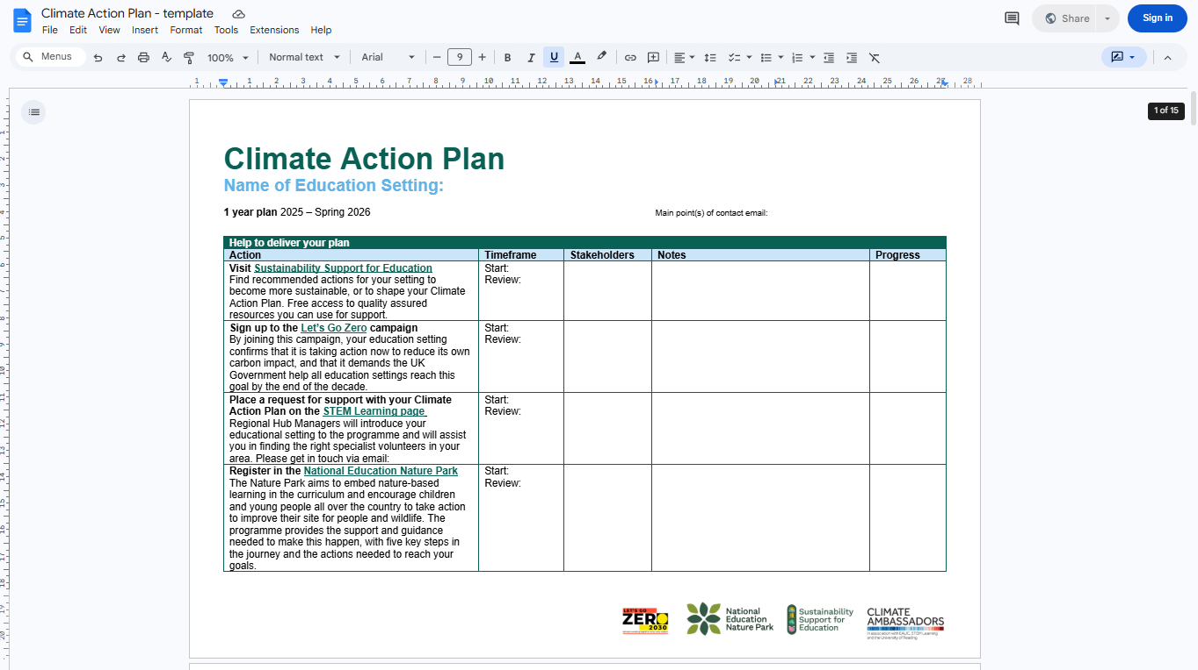
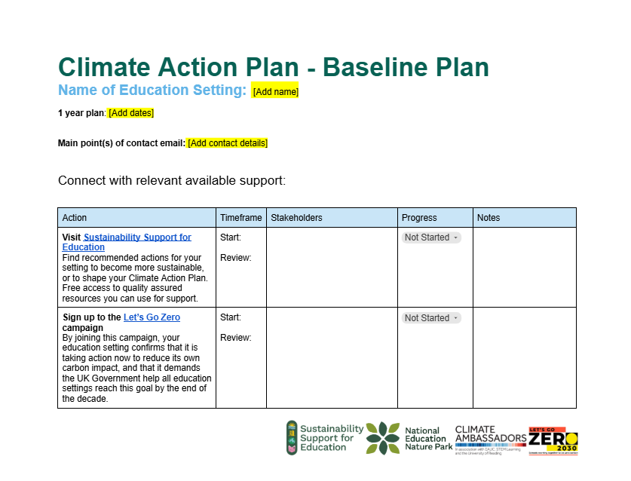
If you are creating a climate action plan for the first time, you may wan to use our ‘baseline climate action plan’. It includes all the actions you need to establish your school baselines, simply add timelines and stakeholders!
Template 1.
Download a template here

Slide 9
If you have already completed your baseline climate action plan, or want to create a more detailed plan, you may find this template a helpful way to structure your plan.
Template 2.
Download a template here

Slide 10
Click to return to contents
2. Adaptation and Resilience
Scope: Ensuring your school can cope with, and recover from, disruption caused by climate change.

Slide 11
Why is adaptation and resilience important?
What is your baseline?
Once you know the extreme weather events you are most likely to face you can then focus on the elements of your school that are most vulnerable to those weather events. To help you think about next steps, you may find it useful to explore one or two tools that show how climate change could affect your school:
Local Climate Adaptation Tool: shows how the local climate may change over time and what risks this could bring.
Climate Just Tool: helps identify which groups or places may be more vulnerable to climate impacts.
Climate Adaptation Toolkit: offers a simple, step‑by‑step approach to preparing for climate risks.
Local Authority Climate Data portal: provides local data on climate trends and potential risks
As climate change warms the earth, weather is set to become more erratic and extreme. In York this means that heatwaves and floods are going to be increasingly common. This is already beginning to impact schools in the north of England:
In 2023, two schools in Scarborough were affected by heavy flooding leading to whole and partial closures.
In 2025, school’s issued emergency guidance and uniform changes to try and keep children safe in the heat.
You can read York’s climate change risk assessment here.

Slide 12
Potential actions i.
Goal | Action(s) | Helpful Links
Baseline: Assess your school’s risk and vulnerability to climate change | Use the links provided in this guide to explore the climate risks your school might face. Identify the most vulnerable elements of your school’s operations (e.g. ageing infrastructure or student wellbeing). | Local Climate Adaptation Tool: how local climates change and the risks this creates Climate Just Tool: understanding what creates vulnerability. Climate Adaptation Toolkit: a five-step process to help you prepare Local Authority Climate Data portal: explore the local climate and associated risks WWF Climate Change Resources for schools UK Government Guidance on how to make an emergency response plan UK Government hot weather and heatwave guidance for schools and education settings
Develop emergency response plans to build climate resilience in the school | Establish a protocol for rapid recovery and response after climate events. Ensure proactive planning is in place to mitigate risks to vulnerable staff and students (e.g. health and social vulnerabilities).
Adjust school hours for periods of extreme weather | Have a policy in place for adjusting school hours during extreme weather events.
Monitor heat in classrooms | Install classroom heat sensors. Train staff to be able to use them and identify dangerous heat levels. React to heat levels with appropriate policy and procedure.
Create a policy to relax the dress code in periods of hot weather | Encourage pupils to wear loose, light coloured clothing. Sunhats and sunscreen. Teachers should also encourage children to take off their blazers and jumpers.

Slide 13
Potential actions ii.
Goal | Action(s) | Helpful Links
Increase school knowledge of climate change adaptation and resilience. | Introduce climate education into the curriculum. Involve students and staff in resilience-building activities. | Adverse weather advice from NASUWT and the Joint Union Heatwave Protocol Energy Sparks Energy Monitors Scheme for student engagement Climate Ready Places Lesson Plans The Pod Water Week RHS Conserving Water Guidance for School Gardens SuDS for Schools ARUP adaptation and resilience measures for schools in London Rainwater harvesting regulations in the UK UK Government flood risk management guidance for schools
Embed water conservation practices in school culture. | Run a campaign within the school about conserving and not wasting water.
Install Sustainable Drainage Systems (SuDS) to reduce flood risk. | Explore options based on the flooding risk of your school. Options include: Rain gardens – linear and non-linear Filter drain Detention basin Pond Permeable surfaces (grass and woodchip) Wetland SuDS rain planters Train staff on how to use and maintain the chosen system.
Install hard floor resilience to reduce flooding risk. | Explore options based on your school grounds. Hard floor options include: Below ground Attenuation tank Flood door barrier

Slide 14
Potential actions iii.
Goal | Action(s) | Helpful Links
Implement natural shading options through tree planting. | Locate suitable positioning for tree planting to create shade. Embed this within the schools’ biodiversity actions to generate co-benefits. | Water efficiency guidance for schools
Install sail shading to help reduce the impacts of overheating. | Locate suitable positioning for sail shading and complete installation. Train staff how to use and maintain sail shades.
Embed water conservation practices in school culture. | Run a campaign within the school about conserving and not wasting water.
Install water-efficient fixtures | Conduct a review of water fixtures and identify where potential efficiency gains could be made. Implement relevant measures. Options include: Low-flow taps Dual flush toilets Rainwater harvesting Train staff on how to use and maintain fixtures.

Slide 15
Click to return to contents
3. Biodiversity
Scope: Ensuring your school is enhancing and protecting natural habitats on and around your school site.

Slide 16
Why is biodiversity important?
What is your baseline?
According to the Department for Education biodiversity is “the variety of all living organisms – plants, animals, fungi and microorganisms – and the ecosystems they form, which sustain life on earth”.
Biodiversity underpins everyday life. It supports the food we eat, the jobs people rely on, and the natural spaces that improve health and wellbeing. A healthy natural environment also helps schools and communities by absorbing carbon and reducing the impacts of flooding and extreme heat. Protecting biodiversity therefore benefits people, places, and long‑term resilience.
York aims to become a pollinator friendly city through it’s Pollinator Strategy and is aiming to increase tree canopy cover in the city by 10% each year. This will create a cooler, greener, more nature friendly city for all York’s inhabitants.
To understand how you can protect and enhance biodiversity within your school site, begin by getting a sense of the existing habitats and potential habitat areas you have on site. You can use GIS technology and fieldwork to do this. The Education Nature Park site has a great resource to help you conduct habitat mapping at your school.
Young people often love and relate to nature and animals so your school’s biodiversity actions can be a great place to start when it comes to engaging pupils with climate change and your climate action plan.
Make the habitat mapping activity a part of your curriculum to bring students along with the process and contribute to the climate education strand of your climate action plan!

Slide 17
Potential actions
Goal | Action(s) | Helpful Links
Baseline: Understand school site biodiversity. | Conduct a biodiversity audit to identify existing habitats, species counts and areas for potential development. | National Education Nature Park educational resources. Sustainability Support for Education’s compiled list of free resources and funding opportunities related to biodiversity. Eden project guidance on growing wildflowers on school grounds EAUC guidance on biodiversity Hedgehog Friendly Schools Free trees from Woodland Trust
Create new habitats and green spaces. | Plant pollinator-friendly flowers, hedgerows and meadows. Install bird or bat boxes. Build bug hotels.
Integrate biodiversity into the curriculum. | Incorporate outdoor learning into science and geography lessons. Involve pupils in habitat monitoring. Create an Eco/ Nature Club or student nature council.
Reduce the impact of grounds maintenance. | Shift to a low-mow policy. Reduce pesticide use. Compost green waste.
Engage the wider community. | Run activities such as biodiversity days or tree-planting events. Launch a citizen science project.

Slide 18
Click to return to contents
4. Climate Education and Green Careers
Scope: Ensuring your school provides quality climate education and prepares students with the skills they need to embark on green careers

Slide 19
Why is climate education important?
What is your baseline?
Climate education ensures that students understand local and global environmental challenges, including their causes, impacts and solutions. Accompanying climate education with the promotion of green careers and green skills means providing students with an insight into the future roles they could play in addressing the challenges of climate change.
A curriculum mapping activity could help you identify opportunities to weave climate education across the learning experience at your school.
The Climate Education Toolkit has example maps for each Key Stage and advice on how to conduct your own curriculum map.

Slide 20
Potential actions
Goal | Action(s) | Helpful Links
Baseline: Understand where climate education is already taking place and how it could be incorporated further. | Conduct a curriculum mapping exercise using the guidance from Climate Education Toolkit to understand ongoing work and future opportunities for climate education. | See the next slide for a full breakdown of the resources you may find useful.
Use your climate action plan actions as teaching and learning opportunities. | Engage students with your school's habitat mapping and count your carbon exercises to incorporate work towards your climate action plan within the curriculum
Participate in Woodland Trusts free ‘Trees for Schools’ scheme. | The scheme provides a host for resources to allow your students to participate in tree planting (contributing to adaptation and biodiversity) as a learning experience.
Follow National Education Nature Park’s five step process to embed nature-based learning in the curriculum. | Register on the National Education Nature Park website.

Slide 21
Climate education resources
Resource | Details
STEM Green Careers Website | A great hub with good resources to get started on green career education.
National Education Nature Park Website | A variety of posters and videos to help learners explore the variety of green careers available.
WWF Sustainable Futures Resources | A certified course on Sustainable Futures designed for secondary and college children.
Green Jobs for Nature Resource | Guidance for students interested in exploring a green career.
Trotman’s Green Careers Hub | Various profiles, lesson plans and posters to aid students exploring green careers.
Green Careers Week | Green Careers Week takes place in November each year aimed at allowing young people to explore the green career options available to them.
OCR taster Sustainability Resources | Exam-board-regulated content for KS3 and KS4 students
BBC Bitesize resources | Simple but detailed content.
National Education Nature Park Resources | A vast library of curriculum-linked climate, nature and environmental education resources for students of all ages.
Global Action Plan Education Resources | A wide range of resources exploring topics from climate and biodiversity to values and wellbeing.
University of Reading CPD resources | Climate and sustainability resources for all staff across all levels of learning to expand and develop their climate education.
Woodland Trust Trees for School | Woodland Trust provide free tree planting packs for schools alongside access to teaching and learning resources to engage your students with tree planting.

Slide 22
Click to return to contents
5. Decarbonisation
Scope: Reducing the greenhouse gas emissions that your school produces.

Slide 23
Why is decarbonisation important?
What is your baseline?
Schools and Universities contribute 36% of the UK public sector greenhouse gas emissions, with an estimated 24% of this coming from schools. The decarbonisation of school sites could therefore make a significant contribution to the countries progress towards achieving net zero carbon emissions. York has an ambition net zero 2030 goal and schools have an important role to play in achieving this goal. Schools in York are already taking action, with many having installed solar panels to help generate green energy.
Decarbonisation also has a host of co-benefits, such as reducing energy building and improving the temperature regulation of buildings.
The Count Your Carbon tool has been designed specifically for schools to allow you to understand what your current carbon footprint is and the key operational areas where your carbon usage is coming from.
Understanding where you can make the greatest carbon reductions is a helpful way of approaching your decarbonisation plans, ensuring you are not investing resources in areas that are already low carbon or where the measures might not make a meaningful carbon reduction,

Slide 24
Potential actions i.
Goal | Action(s) | Helpful Links
Baseline: Understand your carbon intensive activities | Complete a carbon audit to understand what school activities are greenhouse gas intensive. | Free trees available for schools via Carbon Footprint. Solar for Schools provide free solar panels for schools. Complete you carbon audit with Count Your Carbon. Read Count Your Carbon’s nationwide summary of carbon footprints in schools.
Install LED lighting. | Check to see if your school has a Heat Decarbonisation Plan from City of York council which will include details of transitioning to LEDs. Explore funding options such the SALIX scheme (no deadline).
Create natural carbon capture through tree planting. | Tie decarbonisation into your biodiversity actions, exploring spaces where trees could be planted and provide long-term carbon stores.
Install solar panels. | Check to see if your school has a Heat Decarbonisation Plan from City of York council which will include details of where you may be able to install solar panels.
Improve the thermal efficiency of school buildings through insulation upgrades. | Check to see if your school has a Heat Decarbonisation Plan from City of York council which will include details of insulation you can install. Explore the Condition Improvement Fund from Department of Education as a potential funding stream.

Slide 25
Potential actions ii.
Goal | Action(s) | Helpful Links
Reduce waste. | Update procurement policies to prioritise goods made of recycled and recyclable or reusable materials. Help students understand how everyday choices, like reusing, repairing, and recycling, can reduce waste. Explore on-site food composting that could support school gardens in a closed-loop system. | Zero Waste Scotland – Circular Economy in Education. Free Carbon Literacy training from Let’s Go Zero. Making your school more water efficient.
Save water. | Check for easy wins such as leaky taps or toilets. Explore options for more water efficient upgrades for taps, toilets and water fountains when existing infrastructure reaches the end of its life.
Ensure staff are carbon literate. | Ensure key staff have a clear understanding of carbon emissions and can take informed action to reduce them in the workplace.

Slide 26
Potential actions iii.
Goal | Action(s) | Helpful Links
Reduce carbon emissions from travel. | Encourage and promote staff, students and families to participate in active travel for everyday journeys, such as walking, cycling and wheeling to school. Book in pupil Cycle, Bikeability and Pedestrian Training with City of York Council Road Safety Team. Consider setting up Park and Stride sites or walking/cycling buses to enable more pupil active travel journeys. Consider providing drying spaces for wet outdoor clothing from active travel journeys to school. Provide secure and preferably covered cycle and scooter parking for pupils, staff and visitors. Use Modeshift STARS to keep a tidy Travel Plan for your school. Explore funding options for the installation of EV chargers on site. | iTravel York’s Travel to School resources. Register your school for Modeshift STARS. More information on Modeshift STARS.

Slide 27
Click to return to contents
6. Key contacts

Slide 28
Key contacts at City of York Council
City of York Council team | How they can help | Contact details
Road Safety | The Road Safety team can help schools make travel to and from school safer while reducing car use. Safer streets support walking and cycling, helping to cut emissions and improve local air quality. | road.safety@york.gov.uk
iTravel | The iTravel team can help you encourage active travel through a range of initiatives as well as offering support to deal with congestion, unsafe parking and other travel issues your school might be facing. | itravel@york.gov.uk
Healthy Schools | The Healthy Schools website has a host of resources to support you with your climate action plan. This includes promoting active lifestyles, healthy environments, and pupil engagement in sustainability. | healthyschools@northyorks.gov.uk
Climate Change team | If your school is maintained by City of York Council, the Climate Change team may be able to support you with actions such as your decarbonisation or tree planting measures. | carbon.reduction@york.gov.uk

Slide 29
Regional and National support
Organisation name | How they can help | Contact details
Climate Ambassadors | Educational settings can request support from volunteer Climate Ambassadors through this Department of Education funded scheme. Climate Ambassadors can help you develop your climate action plan. | climateambassadors_yh@leeds.ac.uk
Modeshift | Modeshift offer multiple schemes to help your school promote active travel including their Active Travel Inspector Scheme, their Active Travel Ambassador Scheme and their STARS Scheme. | elf@modeshift.org.uk Jason@modeshift.org.uk
Let’s Go Zero | Let’s Go Zero helps schools develop their climate action plan, access funding for green projects and provides practical solutions and ideas to help you reach your green goals. | letsgozero@ashden.org
National Education Nature Park | The National Education Nature Park programme provides the support and guidance needed to make this happen, with five key steps in the journey and the actions needed to reach your goals. | YorkshireNaturePark@rhs.org.uk
Sustainability Clinic at University of York | The Sustainability Clinic pairs your school with a team of students from the University of York, working on a project to help make your school more sustainable. This guide was created by a team of Sustainability Clinic Students! | esay@york.ac.uk
Living Streets | The Living Streets WOW Travel Tracker allows children to record how they get to school, with rewards for travelling sustainably on a regular basis. | Enquire via the WOW webpage.

Slide 30
Click to return to contents
7. Case studies from across York

Slide 31
Huntington School and Fulford School: the first Green Badge holders in York
Two schools are the first in York to earn the Healthy Schools Green Badge for their climate action plans – Huntington School and Fulford School.
“Working towards the Healthy Schools Green Badge has brought so much to our school community. Establishing a dedicated Eco Council and developing a thoughtful, long‑term climate action plan has empowered our students to lead meaningful change. Their passion speaks for itself. As one Year 7 student shared, ‘I love being on the Eco Council and helping the school become even more environmentally friendly… I’m excited for our next project and more in the future.’ Another told us, ‘I am really enjoying being part of the Eco Council and I’m excited for more to come.’
Our older students echo this sense of purpose. A Year 9 member said, ‘I like to make a positive difference to our environment,’ while a Year 12 student explained, ‘I am passionate about improving our school and local environment… I love learning about the issues the environment faces and how ordinary people can make an impact.’ And from Year 11: ‘I want to represent young people’s interests… and improve the surrounding environment.’ Together, these voices show what we have truly gained: a school culture where young people feel knowledgeable, empowered, and united in taking action for a more sustainable future.”
- Huntington School

Slide 32
Stockton-on-the-Forest Primary School Sustainability Clinic Project
Stockton-on-the-Forest Primary school is a small village school with just over 100 pupils aged 4 to 11. Stockton asked the Sustainability Clinic to develop a team of Eco Ambassadors from within our eco club and work with the Eco Ambassadors to assess and improve our outdoor space, creating areas for our children to play and work outside. A member of staff shares more about their project:
“The students delivered 3 eco club sessions where they planned activities for the Eco club to do. The activities were centred around our brief of developing the outside area. They took the children around, got them to draw maps of what they wanted and feedback to us. They made bird feeders with the children and showed them how they can attract wildlife to areas. They also used the leaves from outside for rubbings and looked at identifying the leaves and talking about the different trees they liked.
We have taken on board the ideas that the children had for our playground areas and as such have developed a digging area, big sandpit and reading area. This is a continuous project for us and we develop a new area each half term. Having the children’s views really helped. They also gave us recommendations for different types of funding we can get to put towards developing our forest area. They also gave us some long term ideas of how to attract more wildlife in our school grounds. They suggested ways we could use our grounds to help school with allotments and herb gardens and where’s best to put them. “

Slide 33
Dringhouses Solar for Schools project i.
Dringhouses Primary School worked with Solar for Schools to get solar panels up on their school roofs. Here the school tells us about the process:
“We had many discussions with governors about exploring clean energy. This was primarily to assess the impact this would have on the school budget to potentially help alleviate the cost of rising energy bills and the pressure this was putting on the school’s finances. Other schools in the LA had already used Solar for Schools and through discussions with them and the council regarding the any legal or planning permissions we decided to go with them. Solar for School surveyed the school roof and drew up plans for how many and where the panels could be installed. They calculated the potential savings for the school and the set out the maintenance package which would be required. The process was very simple.”

Slide 34
Dringhouses Solar for Schools project ii.
“Each month the school receives an invoice bill, and this states the savings that the school has made both financially and environmentally. However, this is based on a comparison for the unit/standing charge of the school provider at the time of the installation. As energy costs are very volatile at the moment this is not actually a true reflection of what savings have been made. Environmentally I do believe that the solar panels are making a difference but in terms of cost reduction to the school's energy bill, we are yet to see any considerable impact. We track this carefully in school.
Solar for School offer some excellent educational programmes, including workshops and assembly, which are often free of charge to the school. They have worked with our school council before to show the benefits of solar energy, and we intend to use them in the future for workshops in school.”

Slide 35
Huntington Primary Academy Sustainability Clinic Project i.
Huntington Primary Academy worked with University of York Sustainability Clinic to find a sustainable way of watering their raised beds. A member of staff shares more about their project:
“Huntington Primary Academy is committed to environmental issues and actively tackling climate change has been awarded the prestigious Eco-Schools Green Flag with Distinction. Linked to the Healthy Living topic, we have recently constructed 7 raised beds (1 per year group), with the aim of promoting healthy eating. In Spring 2025 they worked with a Sustainability Clinic team to develop a planting strategy for each of the raised beds, working with the school’s Eco Warriors to involve the whole school in growing edibles and learning how to make a healthy meal or recipe. The school also worked on a composting project through the Sustainability Clinic. A vital success factor in growing fruit and vegetables and the ongoing maintenance of the raised beds is a reliable source of water. The Academy Trust has issued specific health and safety guidance around the use of water butts and standing water which restricts the school to one water butt. Unfortunately, at times of low rainfall this very quickly runs dry leaving no available water source for the irrigation of the raised beds. The students researched possible solutions available, providing case studies from other schools or similar educational settings such as Forest Schools. The school had a very limited budget which needed to be taken into account with any recommendations made.

Slide 36
Huntington Primary Academy Garden Bed Sustainability Clinic Project ii.
The group of students were very keen to listen to all our requirements. They made an initial site visit to see the area they were working with, took photographs and measurements and then we held a meeting where we could discuss the project and desired outcomes. We had great email communication all throughout the project and also held zoom meetings when required.
The students were keen to present their findings and presentation and did so with a very professionally designed project booklet with full researched costings and considerations for our needs. The project was successfully used in a funding application with Yorkshire Gardens Trust for a grant of £300. We could then match fund this with our PTA for a further £300 which has secured the money needed to fully fund the new shed which will house the water butts system safely and securely for our staff and students to use.
This has been a wonderful legacy project, we have nominated the students for the University of York Student Community and Volunteering Awards and I am pleased to say they have been successfully shortlisted.”

Slide 37
Active Travel Ambassadors at Applefields School and Huntington School
Applefields School utilised its adaptable timetable to allow for longer in-depth sessions. Their Active Travel Ambassadors established a ‘Satellite – Be Bright’ reflective gear shop to support safe active travel which they took to their local feeder primary schools. They have been awarded the Modeshift STARS National SEND School of the Year and most recently pitched their new ‘Travel Buddy’ passport programme to City of York Council, Modeshift and Bikeability.
Huntington School is delivering the Active Travel programme to all its Year 12 students as part of their summer term PHSE. After a series of sessions four tutor groups pitched their campaign ideas to a panel of experts from City of York Council and the school’s Senior Leadership Team. One group was awarded £200 to run their ‘Bus Behaviour’ campaign. Titled ‘No Fuss on the Bus’, secret inspectors (pupils) will be on the school buses marking each journey for behaviour issues such as noise, tidiness and manners. There will be three weeks of judging and each week the best bus will be awarded a whole bus prize.
Case study written by Modeshift. You can read the full case study via their website.

Slide 38
Climate Ambassadors at Carr Infant School
A biology student at the University of York enrolled as a Climate Ambassador alongside her studies and was matched with Carr Infant school who wanted help developing and delivering the school’s climate action plan.
The collaboration resulted in the school completing its climate action plan. Now the ambition for this partnership is to securing a £5,000 grant from the National Education Nature Park to boost biodiversity in the school grounds.
Case study written by the University of York. You can read the full case study on their website.

Slide 39
Click to return to contents
8. Get recognition for your climate action plan

Slide 40

North Yorkshire and York Healthy Schools Green Badge and Certificate
The North Yorkshire and York Healthy Schools Green Badge recognises schools that have successfully completed their climate action plan and demonstrated a strong commitment to environmental sustainability.
This badge celebrates schools that are actively reducing their environmental impact, engaging pupils in climate education, and embedding sustainable practices across the whole school community.
Schools can apply for a Green Badge and certificate by submitting their completed climate action plan through the Healthy Schools platform.

Slide 41

Uploading your climate action plan
Visit the Healthy Schools York and North Yorkshire website/
Click ‘start an award’ and select ‘start a schools award’
Login, or register for an account if you don’t have one.
Select ‘climate action plan’ from the Schools Award Menu
Upload your climate action plan.
City of York Council and Healthy Schools York will review your plan and provide feedback.
You will receive your green badge and certificate!
For more guidance, navigate through following pages for a visual explanation of how to upload your climate action plan.

Slide 42
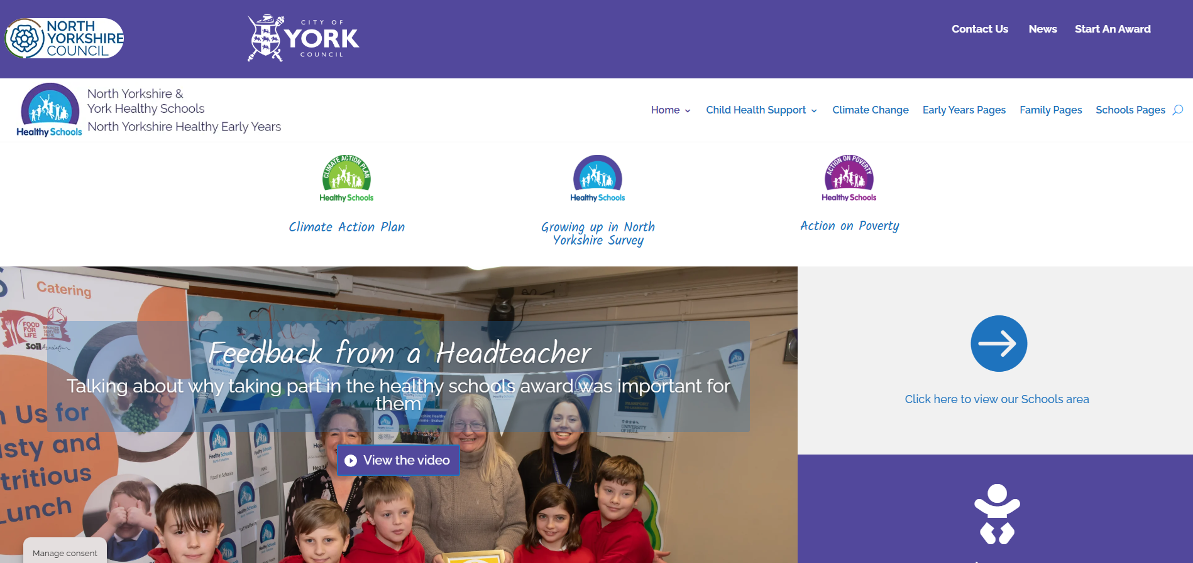
Step 1. Head to the Healthy Schools North Yorkshire Website and click ‘Start and Award’

Slide 43
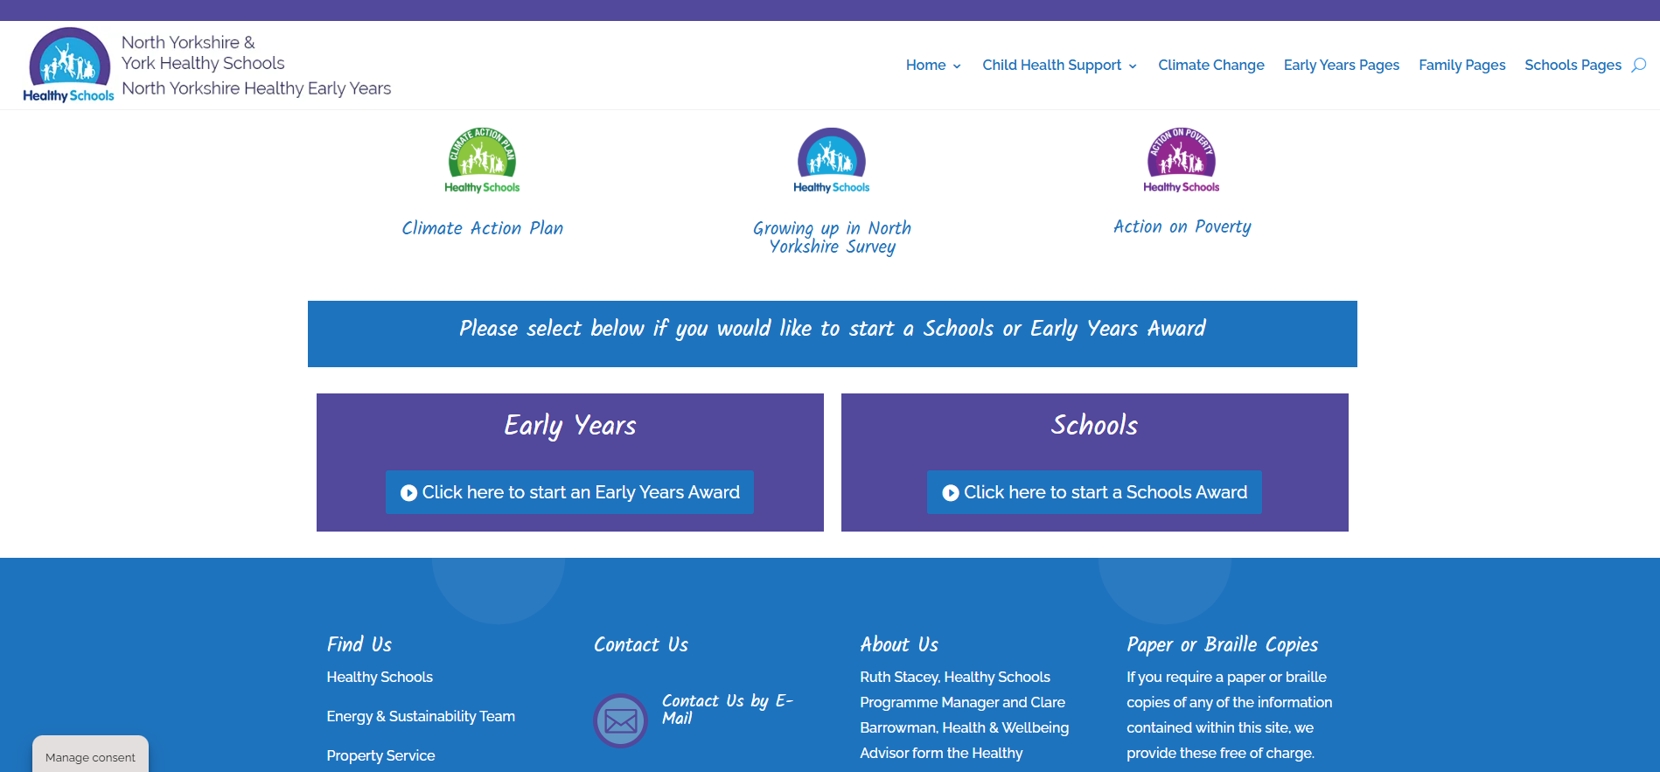
Step 2. Select ‘Click here to start a Schools Award’

Slide 44
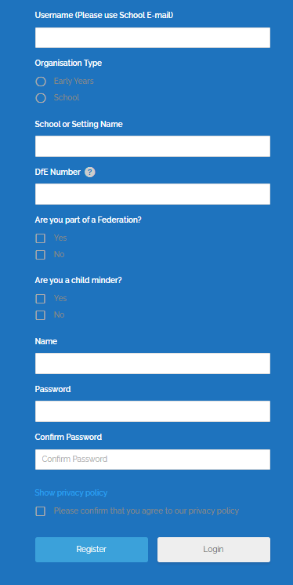
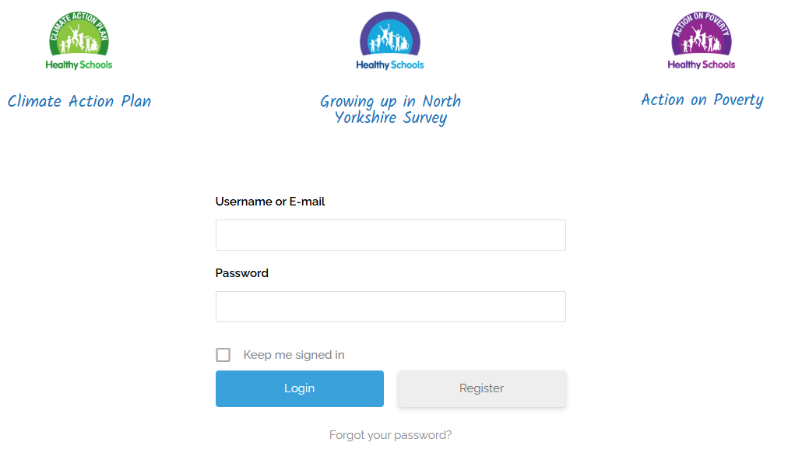
Step 3. If you don’t have an account, click ‘register’ and complete the registration form

Slide 45

Step 4. Once you have logged in, select ‘climate action plan’ from the Schools – Award Level menu

Slide 46
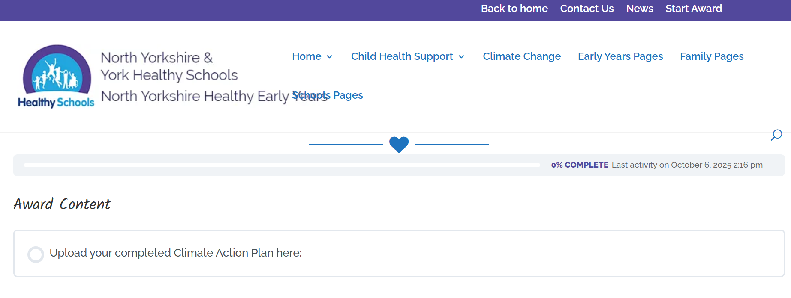
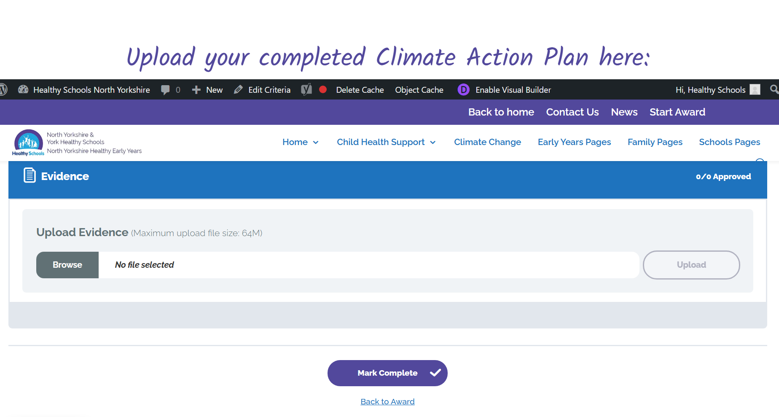
Step 5. Click ‘upload a copy of your climate action plan’

Slide 47
Set submission dates
There are three set submission dates each academic year for schools wishing to apply for the Green Badge. You can find the full details of the submission deadlines on the Healthy Schools website, so you can plan ahead and make sure your application is submitted on time.
Contact Details:
If you need any support applying for your Green Badge, please contact Ruth Stacey, Healthy Schools Programme Manager: healthyschools@northyorks.gov.uk

